Slide 1



A Brief Overview of the
Mobile App Ecosystem
September 13, 2012

Slide 2
Presenters
Pam Dixon, Executive Director, World Privacy Forum
Jules Polonetsky, Director and Co-Chair, Future of Privacy Forum
Nathan Good, PhD, Chief Scientist at Good Research
Ron Soffer, Independent App Developer, former app developer for WebMD
Adam Towvim & Matt Tengler, VP of Business Development & Product Director at Jumptap
Lia Sheena, Legal & Policy Fellow at the Future of Privacy Forum

Slide 3
Agenda
Mobile Ecosystem Chart
App Business Models
Mobile Web Browser Overview
Mobile Application Ecosystem
Data that can be Collected
Technical & ToS Permissions
Notice & Design Considerations
More on types of data: Location, Photos, & Contacts
Identifiers & Tracking
Tracking & Opt-out Options
Questions

Slide 4
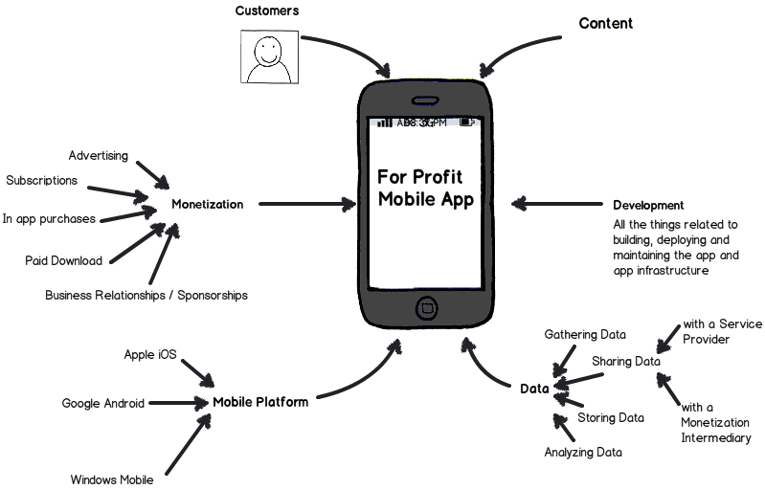
The Mobile Ecosystem What is potentially involved in a for-profit mobile app
Notes:
4

Slide 5
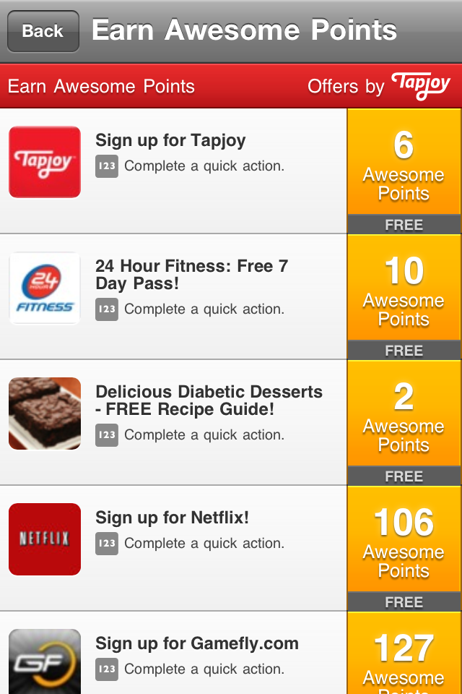
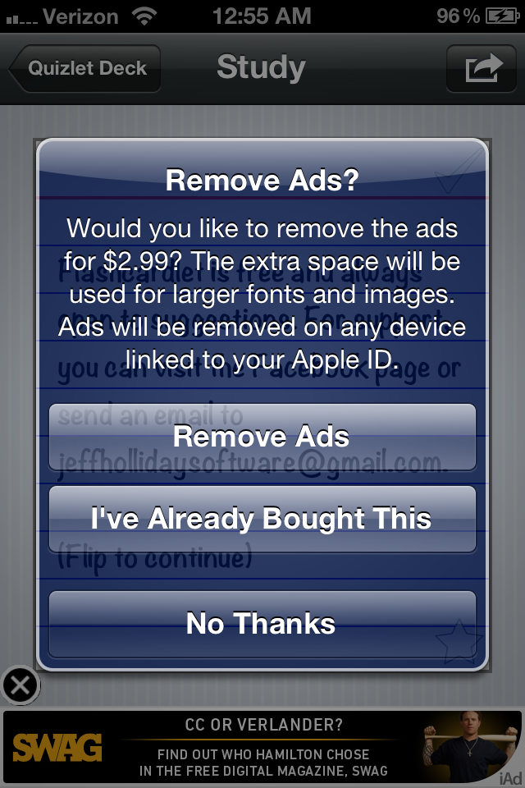
App Business Models
PAID DOWNLOADS
FREE;
AD
SUPPORTED
FREEMIUM;
IN-APP
COMMERCE
FREE;
IN-APP REFERRALS

Slide 6
Mobile Web Browsers
Typical Mobile Browser Privacy Controls
Clear cookies
Clear history
Clear local storage
Safari
Default browser on iOS
Third-party cookie limitations
Clearing cookies also clears Local Storage
Android
"Browser" is default; users can manually install the Chrome browser app
Mozilla
Do Not Track functionality in mobile browser on Android: “Tell sites not to track me”

Slide 7
Native, Web, or Hybrid Apps
Native app (iOS, Android, Java)
Web app (HTML5)
Hybrid App

Slide 8

Mobile App Ecosystem Data Collected Can Include:
Contacts
Photo Library
Videos
Camera/Video Sensor
Microphone
Text Messages
Dialer
Calendar Items
Location
Reminders
User entered info
Social Integration features

Slide 9
Handling of Sensitive Data
Health
Financial
Children

Slide 10
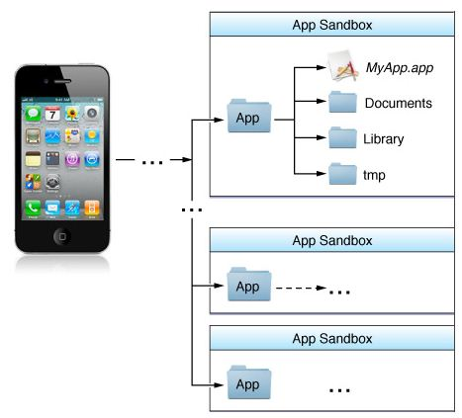
The Apple iOS Approach
App Store Review Plus Sandboxing
“For security reasons, iOS places each app (including its preferences and data) in a sandbox at install time. A sandbox is a set of fine-grained controls that limit the app’s access to files, preferences, network resources, hardware, and so on. As part of the sandboxing process, the system installs each app in its own sandbox directory, which acts as the home for the app and its data.”
“Important The purpose of a sandbox is to limit the damage that a compromised app can cause to the system. Sandboxes do not prevent attacks from happening to a particular app and it is still your responsibility to code defensively to prevent attacks. For example, if your app does not validate user input and there is an exploitable buffer overflow in your input-handling code, an attacker could still hijack your app or cause it to crash. The sandbox only prevents the hijacked app from affecting other apps and other parts of the system.” (iOS Developer Library)
http://developer.apple.com/library/ios/#DOCUMENTATION/iPhone/Conceptual/iPhoneOSProgrammingGuide/TheiOSEnvironment/TheiOSEnvironment.html

Slide 11

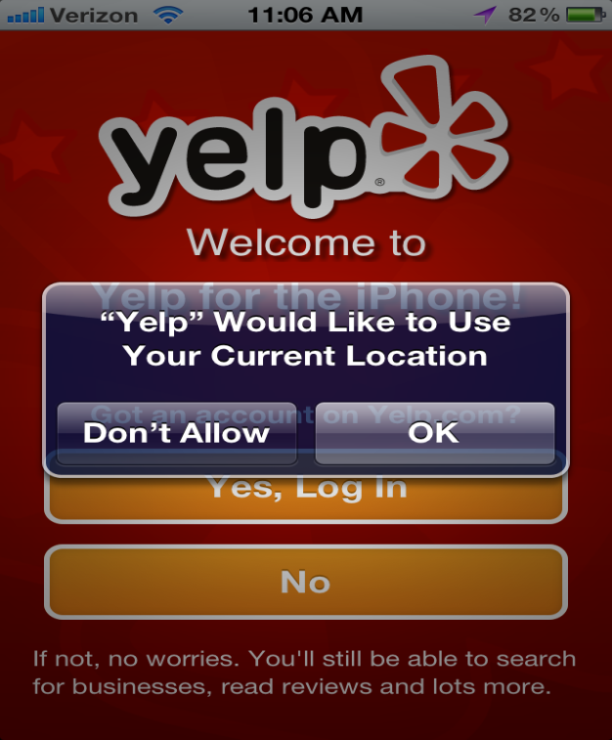
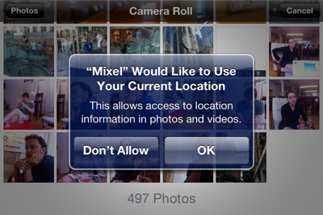
Technical Consent/Permission Models: Apple iOS
When does the OS automatically trigger a request for user permission before providing data?
Location data
Apps that need access to location including apps with access to photos and videos
Triggers opt-in consent pop-up prior to use
Access to other data without declaring in iOS5 API
BUT new in iOS6: app developer must request access to Photos, Contacts, Reminders, and Calendar access which will trigger opt-in consent pop-up
Location Status Arrow icon appears when location is accessed

Slide 12
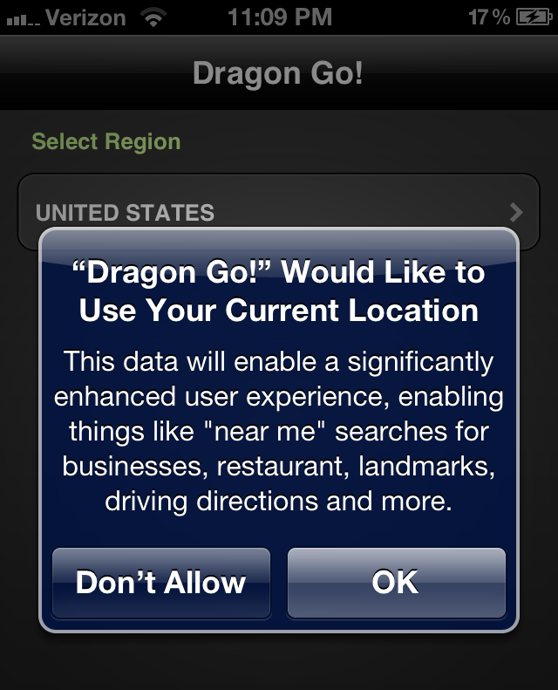
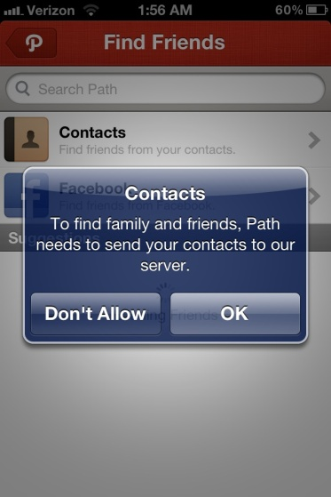
Apple iOS
Ability to Edit Permissions & Add New Permissions
Location Opt-in Notice
Access to location always triggers a pop-up consent request
Developer can edit and add information about the request in the description
Developer can Optionally Trigger other Permissions, e.g. pop-up permission prior to accessing or uploading contacts onto a server

Slide 13
Technical Consent/Permission Models: Google Android
Community Review Plus Per App Sandboxing
Developer decides permissions that the app will have
Permissions declared to user before install
Permissions cannot be changed while the program is running, they are static
Permissions allow for granular access and control of various parts of the phone as well as customer data
Apps can be downloaded from the default Google Play app store or from independent app store

Slide 14
Setting Permissions on Android
Actions
Permissions
Personal Info
Permissions
Display permissions
to user
User chooses to install or not
Determine permissions needed
Describe permissions needed
Hardware Sensor Permissions
System Actions Permissions

Slide 15

Android Permissions: Setting them up
Developer creates a file called a manifest that has the permissions

Slide 16
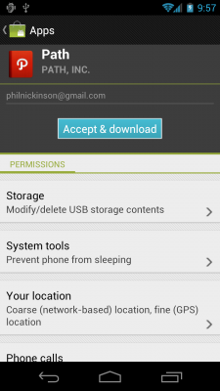
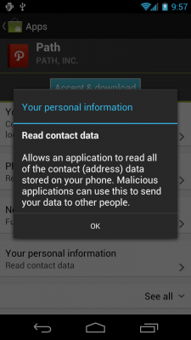
Android Permissions
What the User Sees

Slide 17
Technical Consent/Permission Models: Google Android
Up Front Notice designed to:
Limit dialog boxes
Provide transparency on programs actions before install
Give the user install/don’t install choice before installation
Be decided on before the program runs
Security Architecture Limitations
Reliance on one time customer consent and user attention upfront
“Android has no mechanism for granting permissions dynamically (at run-time) because it complicates the user experience to the detriment of security.” http://developer.android.com/guide/topics/security/permissions.html

Slide 18

Terms of Service Consent Rqmts
Google Android
Microsoft
Apple iOS
“You must provide clear and complete information to users regarding Your collection, use and disclosure of user or device data.” Section 3.3.10 of the iOS Developer Program License Agreement.
“If consent is denied or withdrawn, Applications may not collect, transmit, maintain, process or utilize such data or perform any other actions for which the user’s consent has been denied or withdrawn.” Section 3.3.13 of the iOS Developer Program License Agreement.
“If the users provide you with, or your Product access or uses, user names passwords, or other log-in or personal information, you must make users aware that this information will be available to your app, and you must provide legally adequate privacy notice and protection for those users. Further, your Product may only use that information for the limited purposes for which the user has given you permission to do so.” Section 4.3 of the Android Market Developer Distribution Agreement.
“If your app enables access to and the use of any Internet-based services, or otherwise collects or transmits any user’s personal information, you must maintain a privacy policy…Your privacy policy must (i) comply with applicable laws and regulations, (ii) inform users of the information collected by your app and how that information is used, stored, secured and disclosed, and (iii) describe the controls that users have over the use and sharing of their information, and how they may access their information. You must also provide access to your privacy policy in the app’s settings as displayed in the Windows settings charm.” Section 3(f) of the App Developer Agreement.

Slide 19
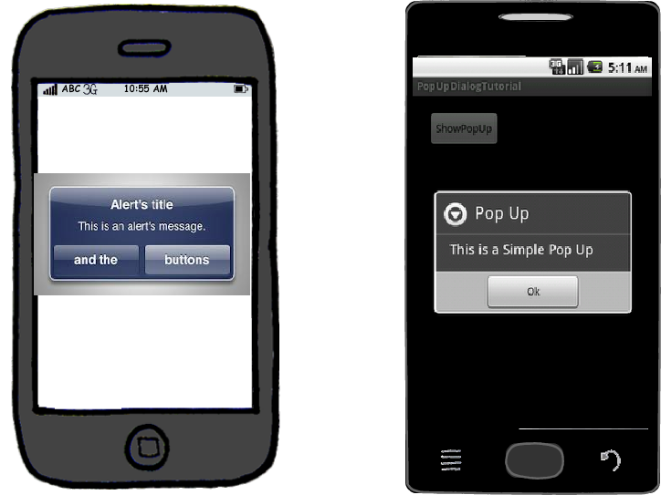
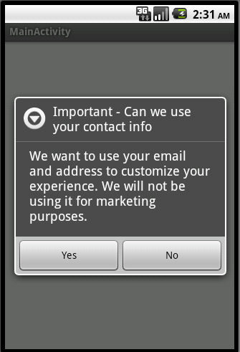
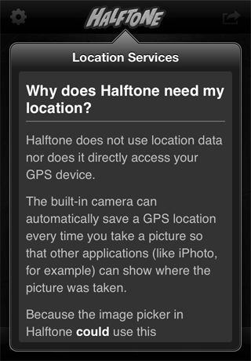
Additional (Optional) Notifications Adding Notice in Context outside of regular permissions

Slide 20
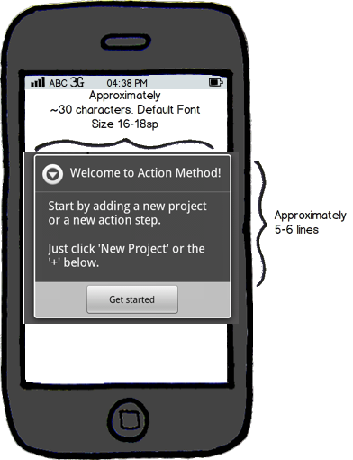
Notice Design Considerations
Screen Constraints
Push notifications
More than just popups, exploring alternate designs
Notes:
20

Slide 21
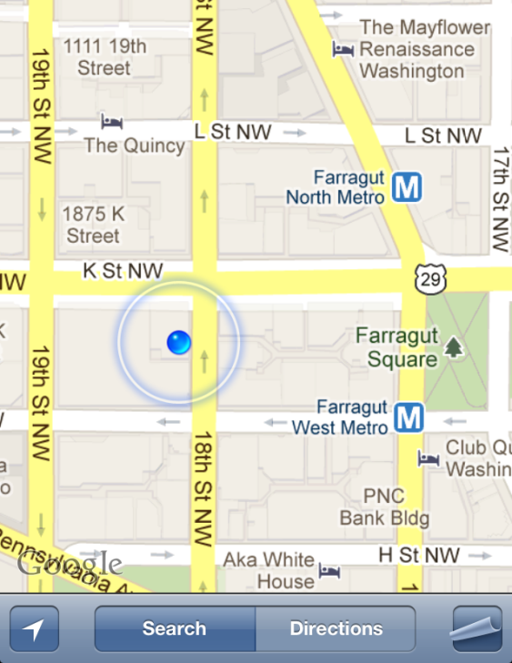
Location
GPS
Wi-Fi
Cell towers
Carriers and services that work with carriers, e.g. Locaid (subject to CTIA guidelines)
Coarse location (Android)
Future? NFC

Slide 22
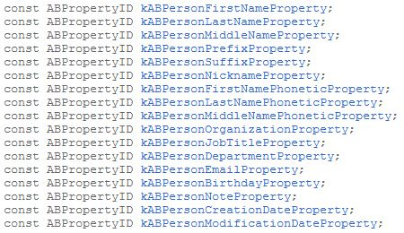
Contacts/Address Book
Apple’s ToS require app developers to request for access but not a technical permission yet (will be in iOS6)
Android’s ToS require app developer notify user of personal info available to the app which is technical permission to “read all of the contact (address) data stored on your phone”

Slide 23
Photos & Calendar
Photo/Video Library
Android doesn’t currently have a specific permission for photo or videos; obtain access to photos and videos by requesting permission to read data from storage cards – subject to change
iOS triggers a location permission upon requesting access to “ALAssetsLibrary”
Calendar & Reminders
Access to calendar on most mobile OSs, e.g. iOS, Android, and Windows
Cannot request access to phone reminders on iOS5, but will be able to in iOS6

Slide 24
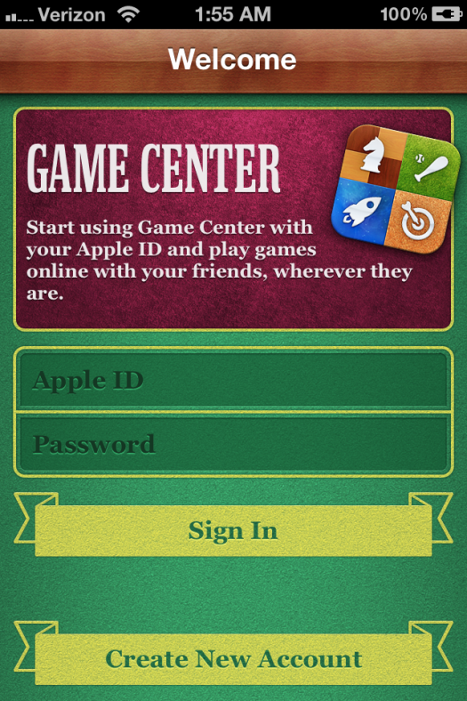
Social Integration Features
Facebook Connect
Apple Game Center
Twitter sharing
Google+
DeNa’s Mobage
Gree’s Open Feint
Papaya
PlayPhone

Slide 25
Working with Third Parties
Analytics SDK
Ad networks SDK
Other intermediaries
Behavioral Advertising
Data appending
Exploits and abuses

Slide 26
What Types of Data do Ad Networks Typically Receive?
Data | App | Mobile Web | Notes
Device Type
Operating System
App / URL
Mobile Network |  |  | When on 2/3/4G connection, IP based
IP Address |  |  | Server-to-server ad calls a challenge
Mobile Browser
Carrier ID |  |  | Accessed via http headers
Device ID |  |  | UDID, Android ID, new iOS ASAdvertiser Manager, etc.
Location Data |  |  | Granularity varies based on user/ publisher, but access to precise geographic location only if app obtained user’s consent
Ad(s) Supported |  |  | Dimensions, MRAID, VAST
Conversions |  |  | Data sharing varies across app / web

Slide 27
Identifiers & Tracking
App cookies are sandboxed
Concerns around the use of device identifiers for app tracking
Security Mechanisms for device identifiers
Google AdMob requires that app developers send back hashed values of the UDID
Many leading ad networks now hash the identifiers they receive on Android and iOS
Types of Identifiers Include:
Android ID; can be wiped upon factory reset
Apple UDID; linked to device, no controls to modify
In August 2011, Apple announced plans to deprecate UDID access
iOS6 provides alternative identifier that can reset by the user
MAC Address; linked to device hardware, no controls to modify
IMEI
MEID
Using iOS Pasteboard
Device Fingerprinting

Slide 28
Tracking & Opt-out Options
Disparate identifiers = disparate opt-out solutions
Mobile ad networks and other leading companies have begun to offer opt-outs
No consistent and single opt-out across app and mobile web
Multiple steps to opt-out
Device identifier not easily accessible by user
Creating awareness of available opt-outs
FPF lists some companies that currently provide mobile opt-outs @ mobileprivacyoptions.org

Slide 29
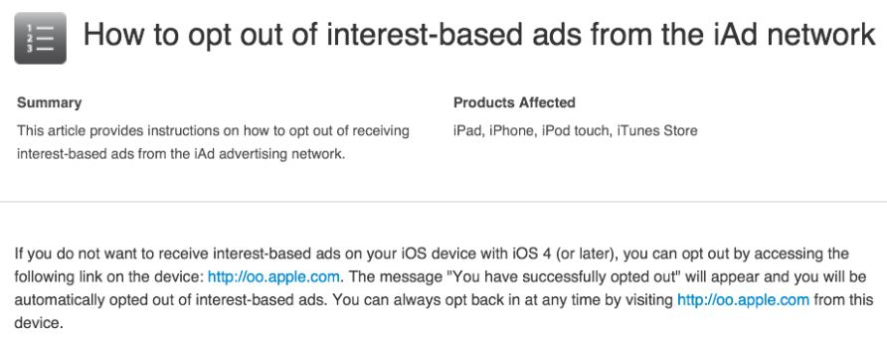
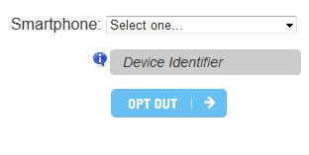
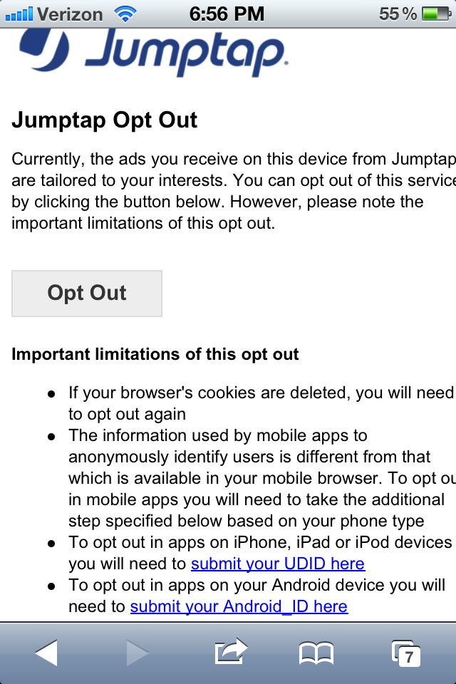
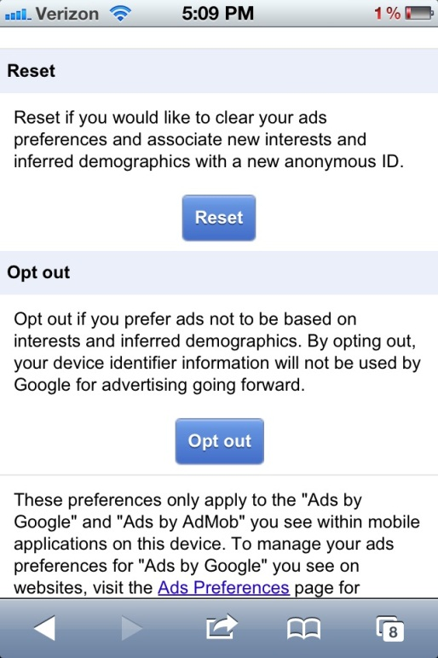

Tracking & Opt-out Options
Apple iAd opt-out
Flurry opt-out
http://oo.apple.com
Jumptap opt-out
Google AdMob Opt-out
LeadBolt opt-out app

Slide 30
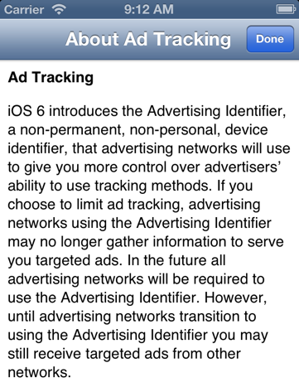
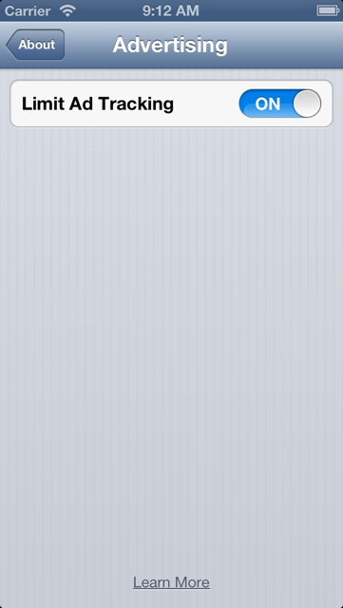
Breaking News: New Privacy Controls in iOS6
“Limit Ad Tracking” is off by default. When the user turns it on, the identifier for advertisers, “ASAdvertiserManager,” can only be used “for the following purposes: frequency capping, conversion events, estimating the number of unique users, security and fraud detection, and debugging.”

Slide 31
Questions?

Slide 32
Thank You!
www.applicationprivacy.org
Research for this presentation was prepared by Lia Sheena and Nathan Good with input from presenters.

