Slide 1
From 0–60:
Privacy and the New Generation of Connected Cars
Josh Harris
Director of Policy
Future of Privacy Forum

Slide 2
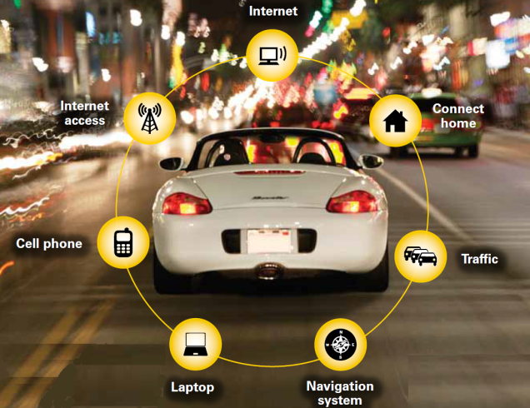
What is a Connected Car?

Slide 3
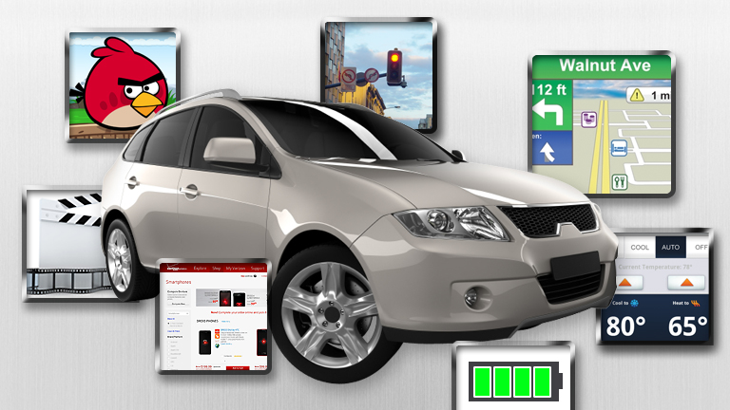
What is a Connected Car?
Autos offering any number of connected technologies, including:
Telematics systems
GPS-based navigation services
Blue-tooth connected mobile devices
About 1-in-5 new cars sold this year will collect and transmit data outside the vehicle.
250 million connected cars globally by end of the decade.

Slide 4




Telematics Systems
Installed at manufacture by the OEM
Examples include:

Slide 5
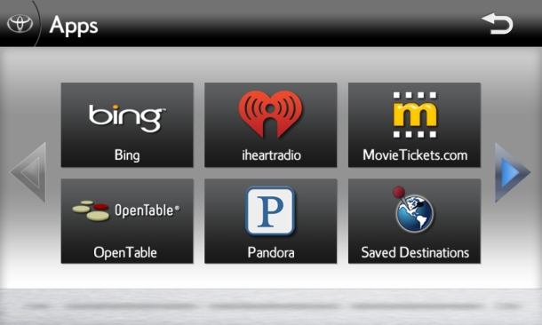
Mobile Apps
Smartphones are used to integrate Internet-based applications with the infotainment platform like Toyota Entune.

Slide 6


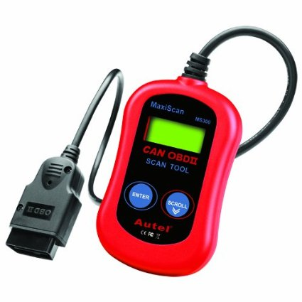
Public/Safety Services
eCall: European Union rapid assistance initiative.
In-Car Vehicle Diagnostic Tools
Event Data Recorders (EDRs) Mandate

Slide 7
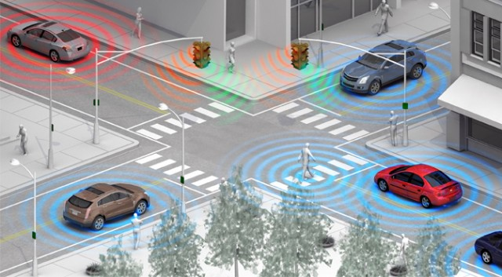
V2X
  Vehicle-to-Vehicle (V2V): “the dynamic wireless exchange of data between nearby vehicles that offers the opportunity for significant safety improvements.”
  Vehicle to Infrastructure (V2I): “The wireless exchange of critical safety and operational data between vehicles and highway infrastructure, intended primarily to avoid or mitigate motor vehicle crashes but also to enable a wide range of other safety, mobility, and environmental benefits.”

Slide 8
Privacy Considerations
Consumer disclosures: When and How?
Categories of information that might trigger such disclosures?
Scope of consumer controls?
Data retention and de-identification policies?
Organizational accountability, how demonstrated?
How do the FIPPs apply?

Slide 9
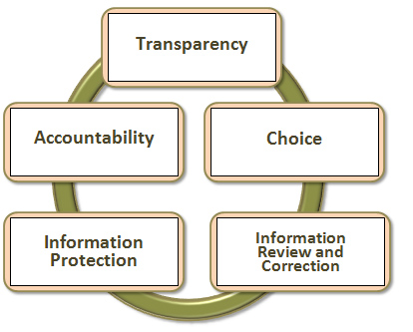
Fair Information Practice Principles

