Slide 1
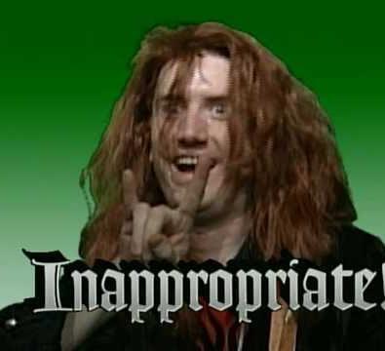
Inappropriate Use of Technology in Schools
David Sallay, Data Privacy Auditor, Utah State Board of Education

Slide 2


Slide 3
What is “appropriate”?
Legal compliance
Avoiding harm
Cost/benefit
Parent INPUT
Intended Use
Effectiveness/ Pedagogical value

Slide 4

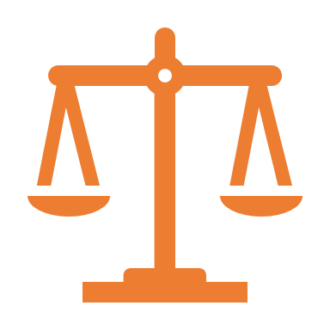
Legal Compliance

Slide 5
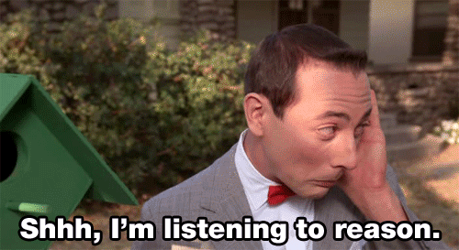
Legal Compliance
Laws like FERPA follow a “reasonableness” standard

Slide 6
What is reasonable?
Teachers share with admin/parents what they’re using in the classroom
Schools request that data be destroyed once no longer used
Parents aren’t denied FERPA rights (e.g., access to records)
Could be based on input from teachers, parents, stakeholders

Slide 7

What about emailing parents?
Parents have a right to access their child’s student records
True, student names are PII
  So are parent names and email addresses!
  It is impossible to email a parent without disclosing PII
Weigh risk and benefits when emailing

Slide 8
CIPA
Children’s Internet Privacy Act
Applies to students younger than 17
Requires schools to have an Internet safety policy

Slide 9
CIPA Internet Safety Policies
Restrict access to inappropriate and harmful materials
Ensure safety and security of minors online
Prevent unauthorized access, including hacking
Prohibit unauthorized disclosure and use of personal information
Include monitoring of the online activities of minors

Slide 10
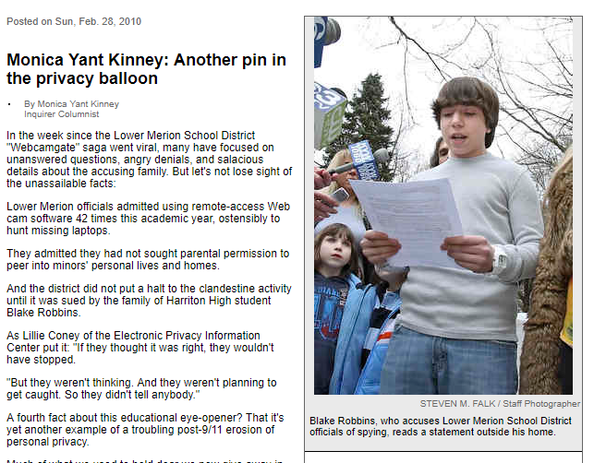
“Webcamgate”
Lower Merion School District (PA) remotely activated student webcams at home on 1:1 devices
Accused of violating the Electronic Communications Privacy Act
Settled outside of court for $610,000

Slide 11

Avoiding Harm

Slide 12

Avoiding harm
Avoiding harm is the underlying reason behind a lot of privacy law
e.g., COPPA exists because it is considered harmful for children to be exposed to targeted ads

Slide 13
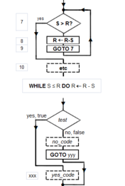
Algorithms
Adequate transparency?
How high stakes are the results? What is the worst thing that will happen if there is a false negative?
Ability to contest decisions (particularly when high stakes)?
Monitoring fairness/Feedback mechanism

Slide 14
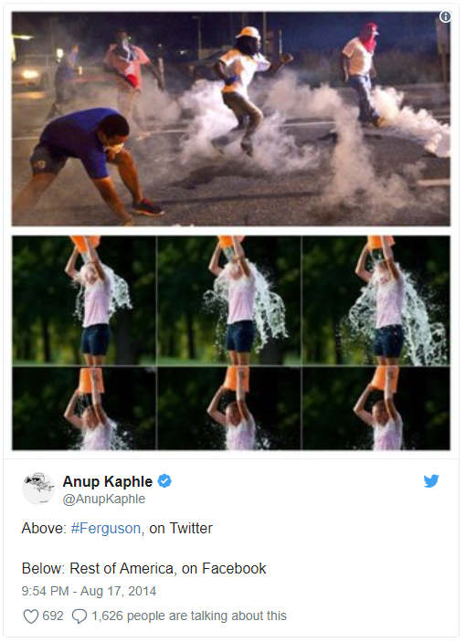
Is algorithmically-filtered content best for students?

Slide 15
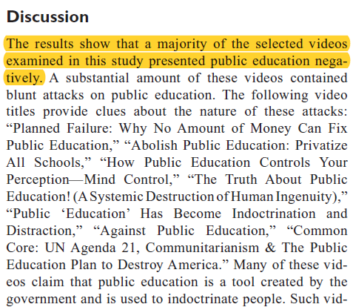
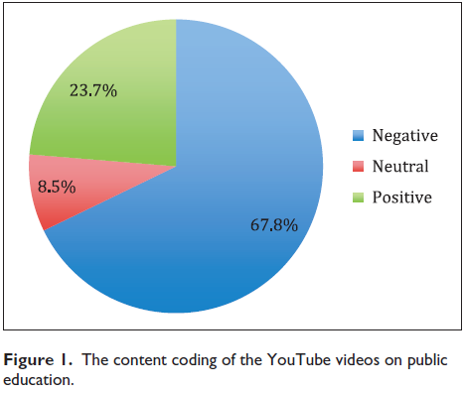
What does YouTube say about public education?
Study by Burhanettin Keskin, “What Do YouTube Videos Say About Public Education?”

Slide 16
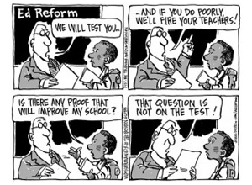
“Teaching to the Tech”
Similar to “teaching to the test,” new technology can lead to “teaching to the technology”

Slide 17
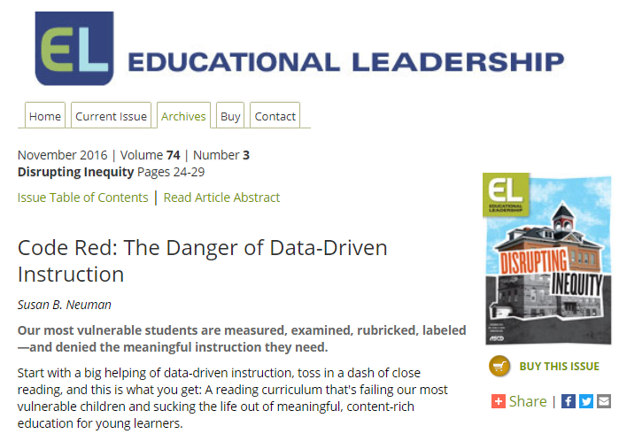
Data-informed or data-driven?
“Using case study analyses, we've interviewed principals, coaches, consultants, and teachers and observed classrooms and grade-level meetings in these schools. We've concluded that data-driven instruction can distort the way reading is taught, harming the students who need high-quality instruction the most.”

Slide 18

Cost / Benefit

Slide 19

More than just $$$
Think of how well students will learn after we achieve our 1 : 1 particle accelerator ratio!
Consider more than just the procurement costs:
Training
Maintenance
Data quality assurance

Slide 20
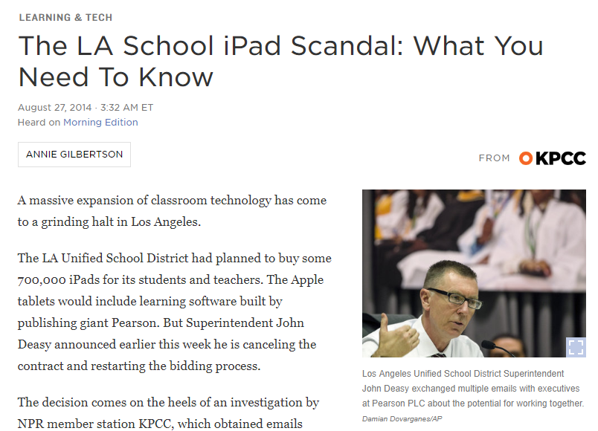
Appropriate use of funds

Slide 21

Potential misfires
From edsurge.com article 2018-07-11:
Privacy aside, [Jason Hong, Carnegie Mellon University] doesn’t think voice assistant devices are really ready for educational environments. They are intended for home use, he says, and teachers should consider the potential for misfires (Alexa could be accidentally activated) and disruptions (a Kindergartner who keeps yelling out for Alexa to turn off the lights). Voice assistants could be useful in specific instances in a college setting, such as a lab where students need hands-free interaction, but even then, there are risks.

Slide 22

Parent Input

Slide 23
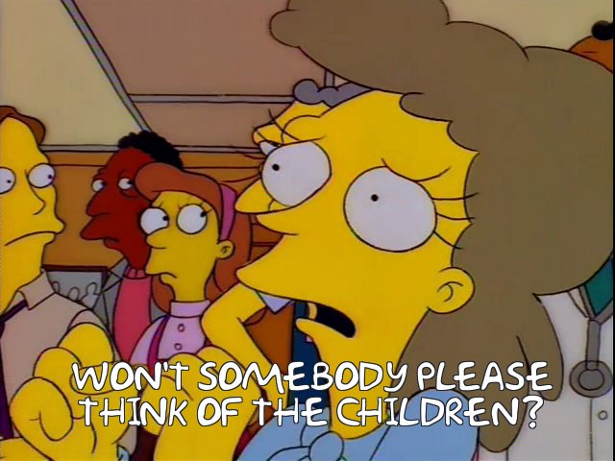
What would parents think?
In general, develop technology policies with parent input

Slide 24
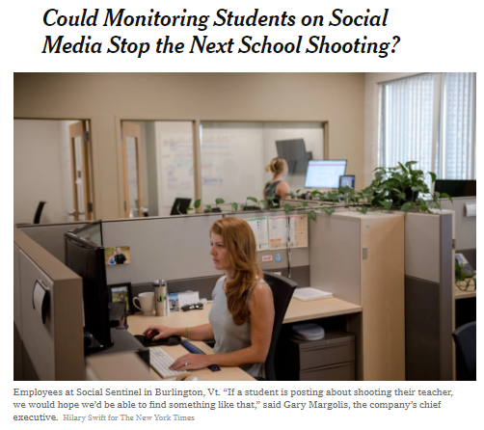
Social media monitoring
Company “geofences” posts from social media that appear threatening
Company shares flagged posts with LEA
Concerns:
  Adequate notice to parents? (no transparency = no accountability)
  Effectiveness?
  Extra liability?

Slide 25

Intended Use

Slide 26
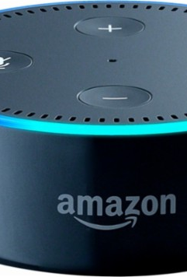
Personal assistants
COPPA explicitly treats “voice” as personally identifiable
However, the FTC says when voice is used as a replacement for written words (e.g., perform a search), they will not take enforcement action
Unclear whether student’s voice would always qualify as part of education record under FERPA
These devices work outside your firewall (so it’s likely that they are violating CIPA)

Slide 27
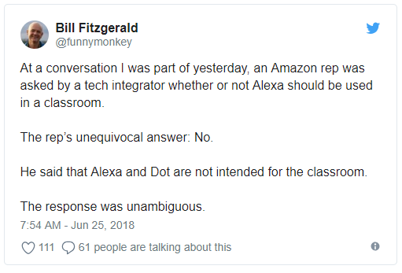
Amazon’s opinion…

Slide 28

Effectiveness / Pedagogical Value

Slide 29
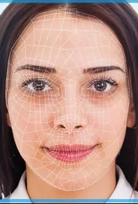
Facial-Recognition for school safety
July 18 Education Week article discusses how more districts are purchasing surveillance/facial-recognition technology to increase school safety
Unclear how effective they are at stopping threats

Slide 30
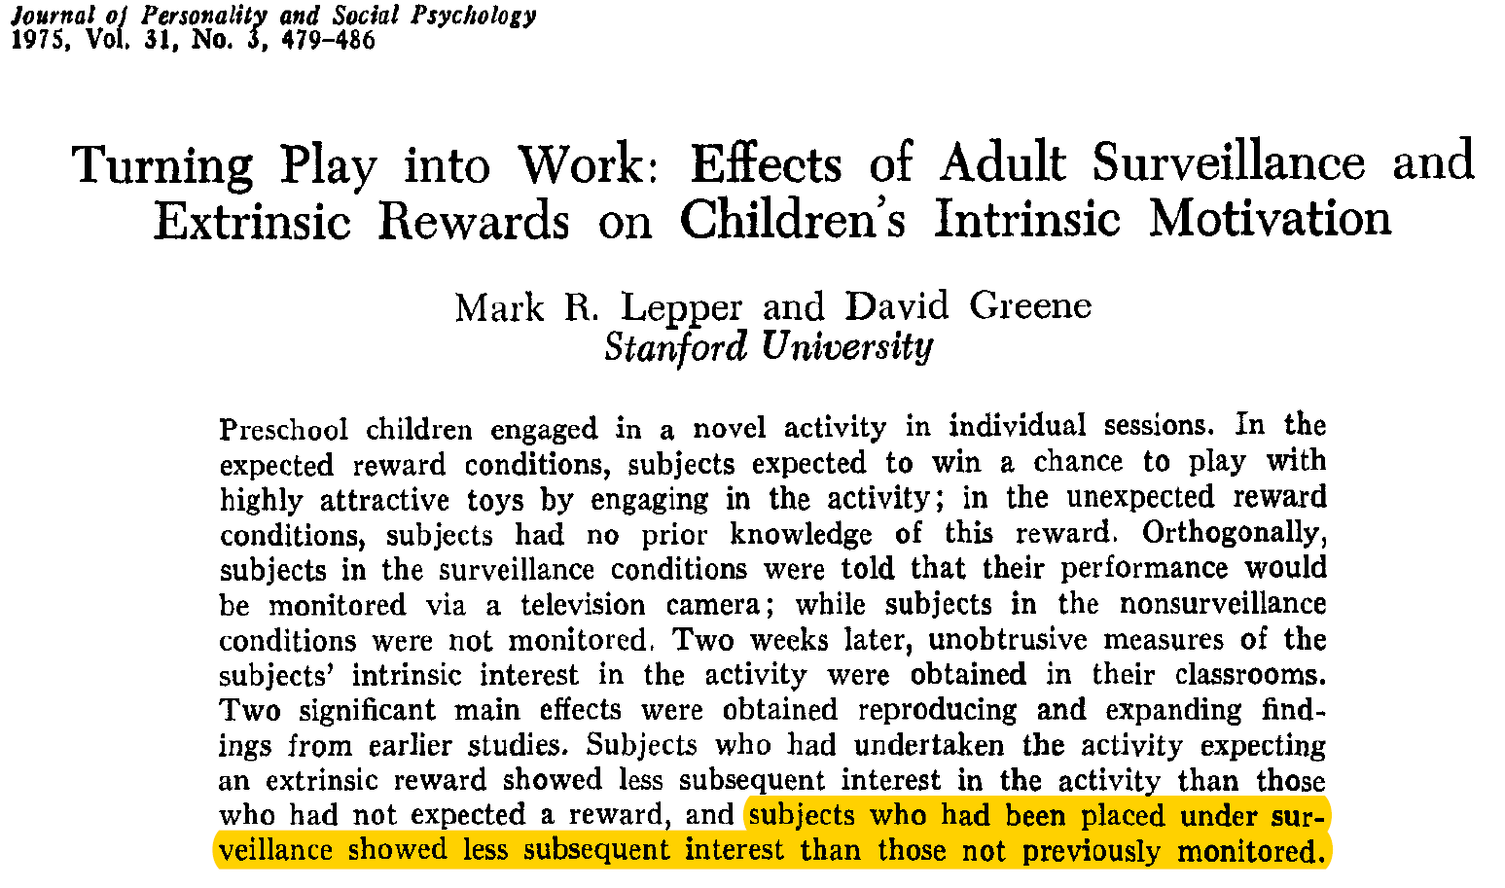
Effects on motivation

Slide 31
Summary
Be reasonable with legal compliance
Consider misfires and unintended harms
Consider all costs
Get Parent INPUT
Use tools for their Intended Use
Ask good questions about effectiveness

