Slide 1


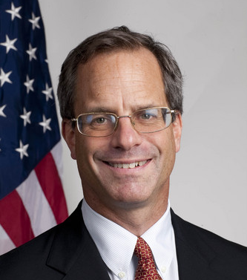
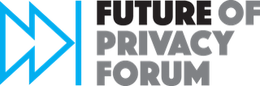
Understanding Federal Preemption
December 19, 2019
Stacey Gray
Pollyanna Sanderson
Professor Peter Swire
Notes:
Stacey - WELCOME
Thank you for joining
We are recording
The video and the slides, and any other content we have will all be posted online by tomorrow
Participants are muted by default
But we have a Chat Q&A where we will be taking questions later on in the hour. If you’re joining us via phone only, you can email us (on next slide) your questions and we’ll try to answer them in real-time if we can.
Also, even though we are recording the video, the chat text doesn’t get saved, so enter any questions, we won’t attribute them to you unless you tell us to.

Slide 2
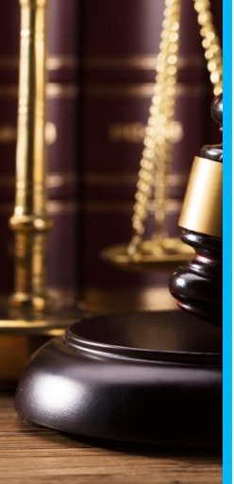
FPF’s Privacy Legislation Series
Goal: Providing independent, pragmatic resources to legislative staff and policy experts working on legislation, in support of a baseline, comprehensive privacy law in the United States
FPF’s Mission: Bridging the policymaker-industry-academic gaps in privacy public policy; developing privacy protections, ethical norms, & responsible business practices.
Upcoming Sessions:
Child Privacy - January 10, 2020
Enforcement
Location Data
First Amendment
… send us your ideas! sgray@fpf.org & psanderson@fpf.org
www.fpf.org
www.fpf.org/legislative-resources

Slide 3
Webinar Agenda: Preemption
Federal Preemption 101 (Introduction and Taxonomy) State Privacy Laws that might be Impacted by a Federal Law Policy Arguments and Future State Laws Discussion: Building Towards Consensus Q&A (20 minutes) & Recommended Readings | Polly Sanderson Professor Swire Stacey Gray Professor Swire Q&A: All
Notes:
Hour long session
20-30 of the hour -- Q&A CHAT housekeeping

Slide 4
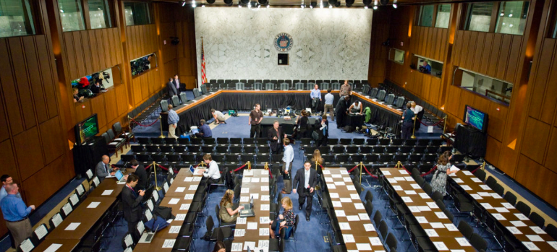
Preemption
Notes:
(Quick Introduction - 30 seconds):
Preemption was a key focus of at the recent Senate Commerce Committee hearing on consumer privacy legislation. As the federal privacy debate moves forward, preemption is taking center stage in both the Senate and the House.
The split on the issue in the recent federal proposals released by Cantwell and Wicker demonstrate that, as bipartisan consensus is reached on many key aspects of comprehensive privacy legislation, the proper role of the States after Congress acts is one of the last remaining questions, not to mention - politically controversial - with industry favoring preemptive provisions to promote uniformity, harmonization, and international interoperability. Those in favor of preemption generally condition their support for preemption on the assumption that federal legislation creates strong federal framework that safeguards for consumer privacy. Privacy advocates, on the other hand, argue against preemption. In particular, they note that a federal omnibus law would prove difficult to amend, and would have negative effects on policy experimentation at the State level. They note that States are more nimble, more responsive to new threats and rapid developments in technology, and to the specific needs of their constituents.
However, although frequently presented as a binary choice between preemption and no preemption, in truth, preemption can take a number of forms, and there is great flexibility in the extent to which a federal law could have preemptive effect.

Slide 5
What is preemption?
Supremacy Clause
This Constitution, and the laws of the United States which shall be made in pursuance thereof; and all treaties made, or which shall be made, under the authority of the United States, shall be the supreme law of the land; and the judges in every state shall be bound thereby, anything in the Constitution or laws of any State to the contrary notwithstanding.
(Article VI, Clause 2, United States Constitution)
Notes:
The foundation of the doctrine of federal preemption is found in the Supremacy Clause of the U.S. Constitution, which declares Federal law as “the supreme law of the land”
Accordingly, federal law can supersede conflicting state laws (and even State Constitutions).
Usually, Congress chooses to preempt state laws when the subject matter is of uniquely federal concern, for example in creating a comprehensive regulatory environment for major industries that cross state lines -- like airline safety, banking, or drugs and medical devices.
As a result, one modern scholar called preemption “the issue of constitutional law that most directly impacts everyday life.”

Slide 6
Basic Taxonomy
Federal Preemption
Increasingly strong presumption against preemption if a bill is silent
Congressional intent is the “ultimate touchstone”
Express
Implied
May be accompanied by “savings clauses” and other mechanisms to preserve existing or future state laws
Field
Conflict
Examples:
Immigration;
Nuclear safety;
Locomotive equipment
Impossibility
Obstacle
Example:
Generic drug labeling
Example:
Blocking federal civil rights goals (e.g. procedural barriers to bringing 1983 claims in state court)
Source: CRS Report (2019)
Notes:
Whether, and how, to preempt state laws is a complex task. It necessarily involves consideration of principles of federalism, political ideology, the quality of the legislation at hand. The values of individual privacy interests and necessary consumer protections must also be balanced against other policy objectives such as free speech, the interests of the national economy, trade obligations, and intestate & international competition.
First, a look at the “big picture” of how a federal law can supersede state laws:
Express
Express preemption refers to the existence of an express provision in legislation that states the intent of Congress. Courts are increasingly unwilling to look beyond statutory text to discern Congressional intent, so any drop of preemptive language contained in a statute is likely to have a large preemptive effect.
Implied
“Field preemption” occurs where Congress has created a pervasive scheme of federal regulation that implicitly preclude state regulation, or where federal law concerns “a field in which the federal interest is so dominant that the federal system will be assumed to preclude enforcement of state laws on the same subject.” - There are many examples of this, including: alien registration, nuclear safety, aircraft noise, locomotive equipment.
Schwartz has argued that field preemption would be inappropriate in an area as broad as information privacy, which touches upon many existing laws.
Conflicts:
Physically impossible to comply with both laws
State law creates a major obstacle to complying with the objectives of federal laws - so for instance, if Congressional intent is to harmonize the landscape, then it would frustrate Congressional intent if a state were to create a higher standard.

Slide 7
Existing federal privacy laws
Regulatory floors (non-preemptive)
Health Insurance Portability and Accountability Act (HIPAA)
Gramm-Leach-Bliley Act (GLBA)
Video Privacy Protection Act (VPPA)
Driver’s Licence Privacy Protection Act
Electronic Communications Privacy Act
The Right to Financial Privacy Act
The Cable Communications Privacy Act
Employee Polygraph Protection Act
Telephone Consumer Protection Act
Fraud Prevention Act (Do Not Call)
Express preemption provisions:
Children’s Online Privacy Protection Act (COPPA)
CAN-SPAM Act
Fair Credit Reporting Act (FCRA): beyond “floors” and “ceilings”: “subject matter” vs “required conduct” preemption
Notes:
As you can see from this list of existing laws, as a practical matter, preemption is incredibly complex in the context of information privacy law, due to the interplay of federal sectoral privacy laws, state and local privacy regulations, and a wide range of other federal and state laws that touch upon privacy.
Notably, preemption is not the norm for most of our existing sectoral privacy laws, with a couple of notable examples:
In COPPA, preemption was included as part of the bipartisan negotiation
With the FCRA reforms came an interesting innovation in preemption - rather than preempting entire “subject matter”, preemption was narrowed in some areas to “required conduct.” This provides a potential mechanism to limit preemptive effect by creating regulatory ceilings in specific areas, above which states would not be able to create higher standards, while retaining their ability to innovate on the general subject matter at issue. At the end of this webinar, we will talk more about some policy arguments for and against various types of preemption.
CAN-SPAM (which established the United States' first national standards for the sending of commercial e-mail), contains a preemptive provision but the thing to note here is how narrow the preemptive effect is compared to an omnibus information privacy law. None of the laws listed here are an comprehensive or omnibus data privacy law, which by its nature would govern all types of personal information, applying to a very wide range of sectors and different kinds of technologies or online products/services.
Legislative clarity will be essential.

Slide 8
Legislative Drafting
“Related to” (most expansive) - ERISA, FAA Authorization
“Covering” (narrower)
“In addition to, or different than”
“Requirements,” “laws,” “regulations,” and/or “standards”
Savings Clauses:
  Anti-preemption
  Compliance
  Remedies
Example: Wicker Discussion Draft
(a) Relationship to State Law.—No State or political subdivision of a State may adopt, maintain, enforce, or continue in effect any law, regulation, rule, requirement, or standard related to the data privacy or security and associated activities of covered entities.
(b) Savings Provision.—Subsection (a) may not be construed to preempt State laws that directly establish requirements for the notification of consumers in the event of a data breach.
Senator Wicker Staff Discussion Draft (2019)
Notes:
The language of “related to” adopted by the Wicker discussion draft, is commonly interpreted by the courts very expansively, so as to create broadly preemptive regulatory ceilings. “Covered by” is considered to be less restrictive. Reference to preemption of “requirements” is interpreted by the courts as broadly including preemption of state common law duties. Therefore, as currently worded, the Wicker discussion draft would seem to have the effect of preempting state common laws such as contract law and tort law, that touch upon data privacy or security (to name a few).
However, Professor Swire has previously stated that most people presumably agree that it makes sense to maintain the background common law and statutes of broad topics such as torts and contracts….

Slide 9
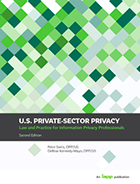
Guest Expert - Professor Peter Swire
Professor of Law & Ethics, Georgia Tech
Senior Fellow, Future of Privacy Forum; Senior Counsel, Alston & Bird LLP
Has testified before 11 Congressional committees
Chief Counselor for Privacy, OMB (1999—2001)
  WH coordinator, HIPAA medical privacy rule
  GLBA financial privacy rule
After Snowden, on NSA Review Group (2013)
Lead author of official textbook to become a certified US privacy professional
Notes:
[Polly to introduce Peter]
Today, we are very fortunate to be joined by Professor Peter Swire, who has been a leading privacy and cyberscholar since the rise of the internet in the 1990’s, and who is a senior fellow with the Future of Privacy Forum. At the beginning of the year, Professor Swire had a two-part article published by the IAPP exploring the practical complexities of preemption in the context of information privacy law. Welcome, Professor Swire!

Slide 10
My role in the discussion
Seeking to share my experience from 25 years in the privacy field
My goal – as close to neutral as possible on the scope of preemption
Technical advisor – trying to help members and staff achieve the outcome you prefer
I have no clients on this legislation, and have taken no position on any provisions
Notes:
[Professor Swire]

Slide 11

There are Many State Privacy Laws
Robert Ellis Smith compilation, $9 on Kindle
Some examples:
  State law prohibits employer from requiring social media password
  State laws restricting display and disclosure of SSN
  Student privacy laws (schools)
  Telephone marketing laws and Caller ID
Notes:
[Professor Swire]

Slide 12
State Contract, Tort, & Property Law
Contracts are widespread for privacy protection
  HIPAA – “covered entity” and “business associate”
  EU – “controller” and “processor”
  Preempt the protections provided by these contracts?
Torts
  Prosser 4 traditional privacy torts
  E.g., right to personality (can’t use my likeness for your advertisement without permission)
Property
  What counts as trespass, eavesdropping?
Notes:
[Professor Swire]

Slide 13
Laws of general application
Fraud – every state prohibits this
  Preempt state identity theft criminal penalties?
Every state has UDAP laws
  “unfair and deceptive acts and practices”
  Many non-privacy ways to act deceptively
  Preempt all state enforcement for deceptive practices?
Notes:
[Professor Swire]

Slide 14
Preemption and Business Certainty
With so many state laws, will have innumerable gray areas – preempted or not
  Federal judges sometimes disagree
  Increases business uncertainty, during years of costly litigation
Can create a process to clarify what is preempted
  COPPA – FTC has authority to decide whether a state law is preempted
  HIPAA – HHS has authority, upon request by a Governor, to permit a state law to apply, even if inconsistent with the federal standard
Grandfathering/Plus One Strategy
Notes:
Plus One:
A “plus one" strategy would involve Congress allowing at least a single state to retain higher standards or to develop standards different from the federal one.
-- Inspired by the Clean Air Act's regulation of pollution from mobile sources; it sets a federal ceiling, but allows a single state, California, to exceed federal emission standards.!94 Other states are permitted to follow the California approach, but they may not enact customized standards.
^ From Paul Schwartz article
Sunset clauses:
States could be given a window of five years with no preemption to allow them to adapt and innovate, after which time the situation could be reviewed. Or vice versa, preempt for five years and sunset the federal law.
Past example: amendments in 1996 to the Fair Credit Reporting Act contained sunsets for a number of statutory provisions that affected billions of dollars in commercial transactions.
With the expiration of these statutory sections imminent, industry was forced to the congressional bargaining table, and at a time when the public had a growing awareness of the shortcomings of existing regulations and new information about the harms from identity theft and risk-based credit
The result was the enactment of FACTA, which - although imperfect - added important new protections to the Fair Credit Reporting Act.
Creating sunsets for preemptions has the additional merit of forcing Congress to reassess the wisdom of its assertion of regulatory primacy. It schedules a revisiting of regulatory choices and thereby creates a safeguard against regulatory ossification.

Slide 15
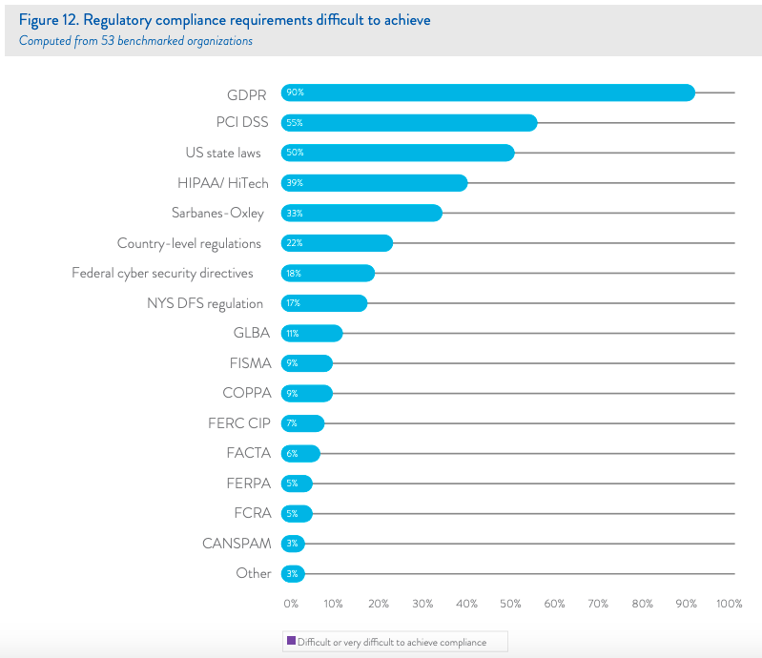
Preemption: Policy Arguments
Arguments for uniformity:
Nature of 21st century economy (privacy is a matter of national and global concern)
Facilitates cross-border data flows
Compliance costs, esp. small businesses
Uniformity for consumers
Practical considerations:
Avoidance of inconsistent regulations in areas with high cost and little policy payoff
  E.g. Data breach notification laws
Establishment of uniform “field definitions” can lower compliance costs, e.g.:
  “Personal information”
  “De-identification”
  “Transfer”/”sale”
  “Collection”
Source: Ponemon Institute
Notes:
First, I think it’s worth noting some of the policy arguments in support of a federal law being broadly preemptive, at least to a certain extent.
The most important is the nature of the modern digital economy. When you visit a website, or use a connected device, your data may be sent to and bounced around on servers all over the place -- nationally and internationally.
You can see these arguments commonly made from within industry, and from industry trade associations, particularly from groups that represent small business interests.
And the political reality is that the push for at least some degree of federal preemption, from the business community, is what is behind much of the current momentum in Congress.
1) The avoidance of inconsistent regulations in areas with high costs and little policy payoff:
Compliance with certain regulations entail high compliance costs with scant privacy benefits) - e.g. data breach notification laws vary and sometimes conflict across the country.
This graph breaks down the difficulty to achieve compliance with different laws. The white paper from which this graph was taken states that data breach notification laws are among some of the highest to comply with. Coupled with this is little to no privacy payoff for consumers.
[Source of graph: http://dynamic.globalscape.com/files/Whitepaper-The-True-Cost-of-Compliance-with-Data-Protection-Regulations.pdf]
2) through the establishment of "field definitions" that can lower compliance costs.
A second benefit of consolidation concerns basic statutory definitions that mark a given regulatory field.
The preemptive power of such a "field definition" prevents states from redefining the scope of a fundamental legislative category
As an example, the Fair Credit Reporting Act contains a detailed definition of "consumer report.”
Congress was wise to enact such basic subject matter definitions; terms that clearly bound the scope of a regulatory field reduce regulatory transaction costs.
it would not make sense to have varying definitions of key terms across the states such as “Personal information”, “De-identification”, “sale”, “transfer”, “collection.”
It also makes sense to create uniform rights for consumers: e.g. access provisions to be uniform so that legislation is not confusing for consumers, and so that consumers have uniform rights no matter where they are in the US.
Note, however, that as technology and businesses evolve, entire new enterprises and modes of data processing may spring up. In that case, states are free to generate a new category or categories for regulation
Arguments in favor of stronger regulatory ceilings
Industry in the United States also has made clear that strong ceiling preemption of state laws that impose requirements for the collection, use, disclosure and storage of personal information, is an essential condition of its support for any comprehensive legislation. The exclusion of preemption from comprehensive legislation is a kind of “deal breaker” for industry. Industry questions why it should have to accept heavier compliance burdens at the federal level only to be exposed to a ratcheting up of requirements every time a state wishes to pass a new privacy law.
The perils of a “patchwork” of state laws
Negative effects for consumers
As already mentioned, those in favor of preemption often cite the perils of the emergence of a patchwork of state laws for consumers and businesses alike. At the recent Senate hearing on consumer privacy, Michelle Richards, whose consumer advocacy organisation has released a preemptive draft bill, testified that having one nationwide standard is in the interests of consumers. She pointed towards the fact that privacy bills at the state level are not as comprehensive as proposals at the federal level, and that CCPA is merely an opt-out law. Both the Wicker and the Cantwell proposals would create greater protections for consumers than the CCPA.
Secondly, she pointed to the fact that consumers would benefit from having consistent rights across the country. It took many years for all the states to enact data breach notification laws. A uniform federal standard would allow consumers, no matter where they are geographically, to have the same detailed comprehensive set of rights. This would also provide clarity for consumers as to what their rights are, making it easier for them to exercise them. This also aligns with user expectations and the promotion of user-centric outcomes. Consumers do not want, nor expect, different baseline privacy rules based on where they live, or where they happen to be at the time, or where the business they are interacting with is based.
In addition to these points, it is also argued that a patchwork of different privacy obligations diverts significant resources which could be spent on the invention of new features for consumers. High compliance costs associated with a fragmented regulatory landscape disincentivises innovation for products that require scale.
Negative effects for businesses
Organisations benefit from consistent compliance programs based on widely shared principles of data protection. Preemption would permit companies and individuals to gain clarity and alignment on expectations for the relationship - for example, by making individual rights of access uniform, as well as measures organizations must take to enable consumers from exercising such rights. This point I explore more elsewhere.
Especially negative effects for small businesses (SMEs)
Information privacy regulation disproportionately impacts SME’s, and a patchwork of regulatory models exacerbates this. In short, it will be hard for SMEs to bear and run profitably. Compliance costs of CCPA are high. The law will regulate over 500,000 businesses, the majority of which are small businesses. The majority foresee spending at least $100,000 on CCPA compliance. This will create regulatory barriers to entry, which is bad for competition.
Compliance costs will only increase as new states enter the regulatory field by enacting comprehensive privacy laws. Companies will need to incur greater costs to comply with the specific requirements in each state and address conflicts between the laws. SME’s do not often have the resources to hire legal counsel to ensure compliance programs that are effective and adaptable across a patchwork of national privacy regulation.
Negative effects for the emergence of micro-multinationals
The ability of SMEs to enter the marketplace and compete with entrenched players is directly correlated to their ability to leverage external infrastructure sources like cloud computing, which rely on the ability to collect and process data within the US and internationally (i.e. cross-border data flows). Cross-border data flows enable the creation of a new breed of SMEs - the micro-multinational - born global and constantly connected. Uniformity promotes cross-border data flows.
[patchwork argument rebuttal]
Interoperability and the promotion of cross-border data flows
Personal data is one component of the “knowledge economy” which “has been recognized for years as a critical driver of economic growth and productivity.” Microsoft’s intelligent cloud, intelligent edge, and AI strategies rely on an internet that it interoperable, open, and globally accessible to as many people as possible. The ability to deliver high-quality cloud services relies on the smooth functioning of the internet infrastructure and the minimization of geographically conflicting regulations. Cross-border data flows drive around 22% of global economic output, adding up to $11 trillion to global GDP by 2025. By promoting cross-border data flows, uniformity therefore also promotes international business. Mechanisms allowing for cross-border data flows are critical to the modern economy. Cross-border data flows are necessary to realize the full economic potential of data-driven innovation and the global economy.

Slide 16
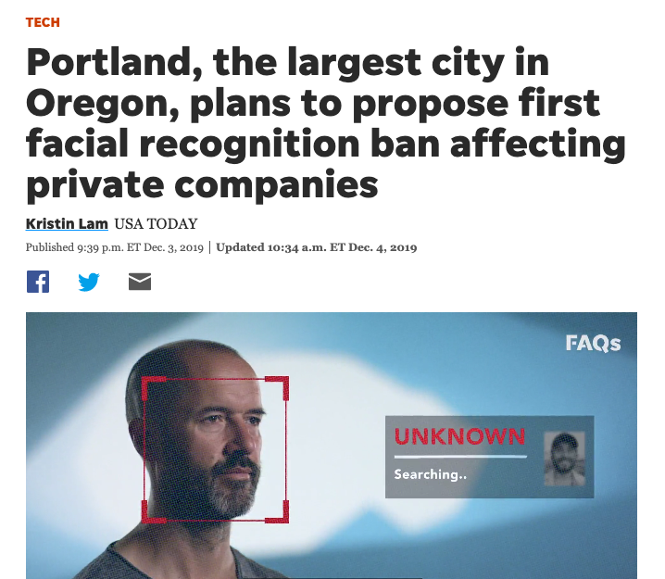
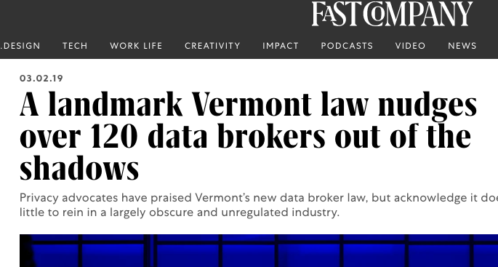
Preemption: Policy Arguments (Against)
Disruption of existing state laws
Laboratories of Democracy: policy experimentation and innovation
States are often the first actors in response to new threats or technological changes (rapid pace of technology)
A federal omnibus law would be difficult to amend in the future (ossification)
Notes:
Arguments in favor of the creation of a regulatory floor
In general, most and consumer privacy advocates have been more sympathetic towards federal privacy bills that would preserve the ability of state lawmakers to create more restrictive requirements for the commercial collection and processing of personal data. Consumer groups and academics cite a number of reasons for Congress to approach calls for harmonization with caution.
States are more responsive to gaps in the law
Over time, the new law is sure to have deficiencies and gaps. States respond more efficiently and effectively to their own constituents, new threats, and technological developments than the federal government. Limiting the scope of preemption would leave room for states to identify, analyze, and respond to emerging gaps in privacy law, thereby deterring harmful conduct and compensating injured plaintiffs. It has been further argued that privacy itself is a driver of innovation, and that states are drivers of privacy. Prohibiting state action may stunt privacy innovation, thereby harming users and decreasing trust of digital products and services.
At a recent Senate Hearing on consumer privacy, Ms. Laura Moy testified that Congress should not entrench upon States regulatory efforts, or eliminate protections at the state level. Americans desire greater protections for their personal information. To avoid harming consumers that benefit from existing protections, it is important for federal action to preserve existing state privacy and data security standards.
States as laboratories for innovation and democracy
There is concern that a ceiling standard would block regulatory experiment at the state level and sectorally. When drafting HIPAA and GLBA non-preemptively, the Clinton administration reasoned that states should have the ability to offer greater protection of the rights of their citizens. Schwartz has argued that States are “laboratories for innovations in information privacy law.” Through diversity, it is argued that states offer simultaneous experimentation with different policies. This provides information about a range of government policies, enabling the nation to choose the most desirable one. As such, they can lay the groundwork for eventual federal privacy protection. In contrast to these arguments, Patricia Bellina has has argued that state privacy laws often follow federal legislation, pointing to the “importance of federal leadership in information privacy problems.”
A federal omnibus law would be difficult to amend
A federal omnibus law would be difficult to amend, with privacy advocates, industry, and other stakeholders garnering enough Congressional support to block significant changes. As such, the law could become quickly outdated as technology evolves to undermine the statute’s regulatory assumptions. This happened to the preemptive National Labor Relations Act. Hartzog & Richards have recently noted that there are many different ways Congress might preempt some but not all areas of privacy law while maintaining a flexible and layered approach to privacy federalism, but generally, limited or no preemption will be the key to an inclusive and adaptive regime.
Who makes these arguments? (privacy advocates and democratic bills, generally)
Regulatory “floor”
Cantwell (D-WA) bill
Schatz (D-HI) bill
Recent Wyden (D-Ore) bill
Free Press proposal
Lawyers Committee
EPIC
Public Knowledge
Access Now
Center for Digital Democracy
Center on Privacy at Georgetown Law
Consumers Union
Electronic Frontier Foundation
US Public Interest Research Group

Slide 17
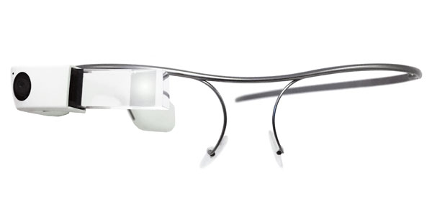

Hypothetical Future State Privacy Laws
Virtual reality
Augmented reality
Rapid epidemic or public health crisis
Evolving drones uses and regulation
Evolving standards for smart cities & smart communities

Slide 18
Discussion: A Possible Path Toward Consensus
Preemption can seem like a zero-sum issue
  Some privacy advocates want no preemption
  Some business supporters want maximum preemption
  If one side “wins” then the other side “loses”
Here is one suggestion for a process that has worked before in Congress
  Find the places where people agree
Notes:
[Professor Swire}

Slide 19
How FISA Became Law in 1978
Post-Watergate, bipartisan support for some new limits on national security wiretaps
  For national security reasons, government couldn’t describe its actual practices
  Solution
    Developed multiple hypotheticals
    Have Congress consider what it wanted for those hypotheticals
    Then, drafted the text that became FISA

Slide 20
A Proposal to Find Areas of Consensus
Examine 20 current state laws related to privacy and cybersecurity
  List which ones you think should remain in place
  For consensus items, go to leg counsel for text
Examine 10 possible future state laws related to privacy and cybersecurity
  Again, see where have agreement
  Go to leg counsel for text

Slide 21
Breaking the Impasse
Perhaps there is consensus on 60% or 80% of the case studies
Draft text for those now
Perhaps also draft alternative text for the case studies where you disagree
That way, when you are close to a final deal, members can make an informed decision about how to negotiate on the remaining, fewer items

Slide 22

Questions?
info@fpf.org
www.fpf.org
facebook.com/futureofprivacy
@futureofprivacy
Notes:
Washington, new york, maryland, (& the CA ballot initiatve)
Biometrics laws
Facial recognition bans
CCPA lookalikes
Professor Swire
We talk a lot about federal preemption, but state laws also frequently
The leading proposals in the Senate Commerce Committee currently have many of the same core provisions
Is it possible to

Slide 23
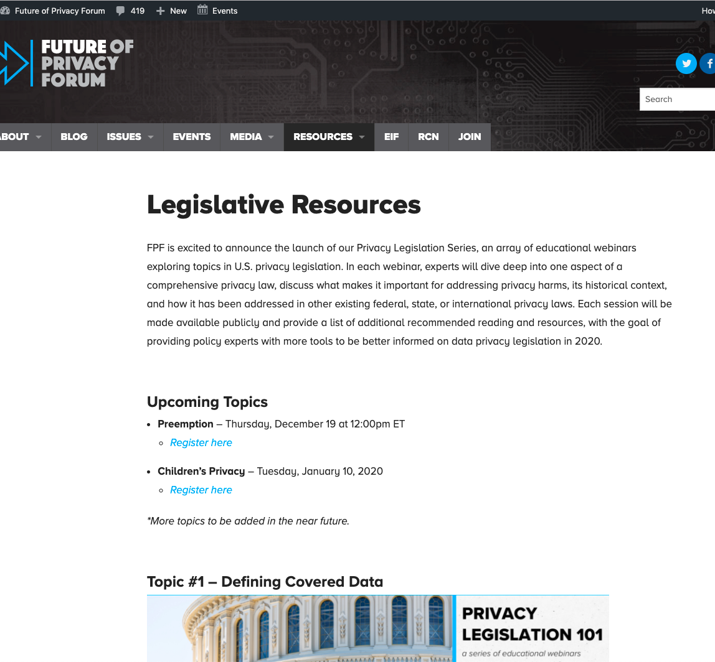
Recommended Reading
Federal Preemption: A Legal Primer (July 2019) Congressional Research Service
Peter Swire, US federal privacy preemption, part 1 & 2 (IAPP)
Paul M Schwartz, Preemption and Privacy, 118 Yale L.J. 902, 912 (2009)
Compilation of State and Federal Privacy Laws by Robert Ellis Smith
U.S. Private-Sector Privacy, Second Edition, Peter Swire, DeBrae Kennedy-Mayo
Joseph L. Seidel, The Consumer Credit Reporting Reform Act: Information Sharing and Preemption, 2 N.C. Banking Inst. 79 (1998)
Patricia L. Bellia, Federalization in Information Privacy Law, 118 Yale L.J. 868 (2009)
Margot E. Kaminsky, Drone Federalism: Civilian Drones and Things They Carry, 4 Cal. L. Rev. Circuit 57 (2013)
Bilyana Petkova, The Safeguarding of Privacy Federalism, 20 Lewis & Clark L. Rev. 595 (2016)
Ira S. Rubinstein, Privacy Localism, 93 Wash. L. Rev. 1961 (2018)
For an industry perspective, see Brad Smith, Senior Vice President, Gen. Counsel, Microsoft Corp., Protecting Consumers and the Marketplace: The Need for Federal Privacy Legislation (Nov. 2005)
Notes:
Thank you for attending FPF's webinar on the topic of preemption. A recording of the webinar, presentation slides, recommended reading, and FPF resources will be made available on a dedicated page of our website. We are also in the process of drafting a written component to this webinar, which will also be made available on our legislative resources page. After christmas, our next webinar will be on the topic of Children’s privacy. Stay tuned for future sessions! Please join our mailing list to receive general FPF updates, publications and news, and follow us on Twitter, Facebook, and LinkedIn.

