Slide 1
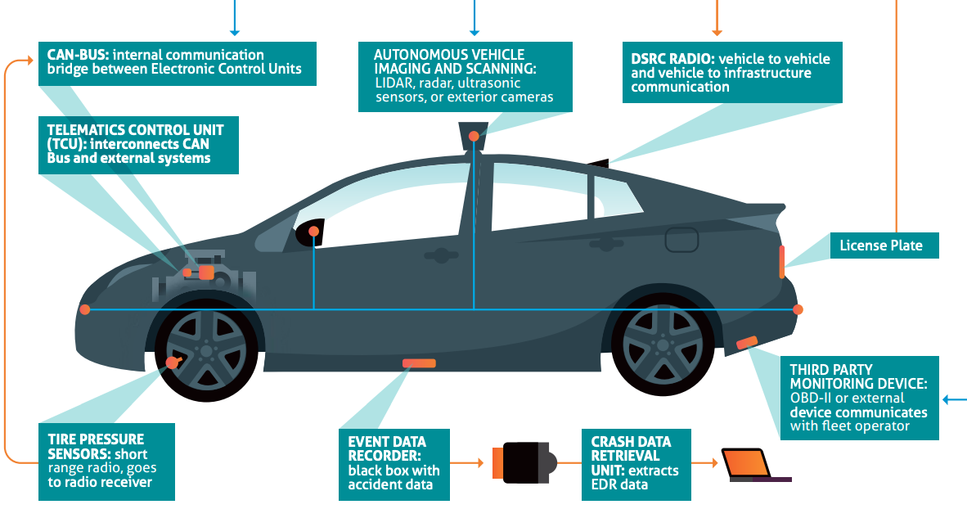


Digital Data Flows Masterclass #7: Connected and Autonomous Vehicles
June 25, 2020

Slide 2
Future of Privacy Forum
Our Mission
Bridging the policymaker-industry-academic gap in privacy policy
Developing privacy protections, ethical norms, & responsible business practices.
Our Workstreams
Mobility & Data
Youth Privacy
AI & Machine Learning
Location & Ad Tech
Internet of Things
Biometrics
De-identification
Smart Communities
Our Supporters
150+
Companies
25+
Leading Academics
15+
Advocates and
Civil Society
5
Foundations

Slide 3
Digital Data Flows Masterclass Series:
Artificial Intelligence & Machine Learning
Location Data: GPS, Wi-Fi, Spatial Analytics
De-Identification, Differential Privacy, and Homomorphic Encryption
Online Advertising Technologies
Mobile Apps
Facial Recognition
Archived videos and slides available at www.fpf.org/classes.

Slide 4
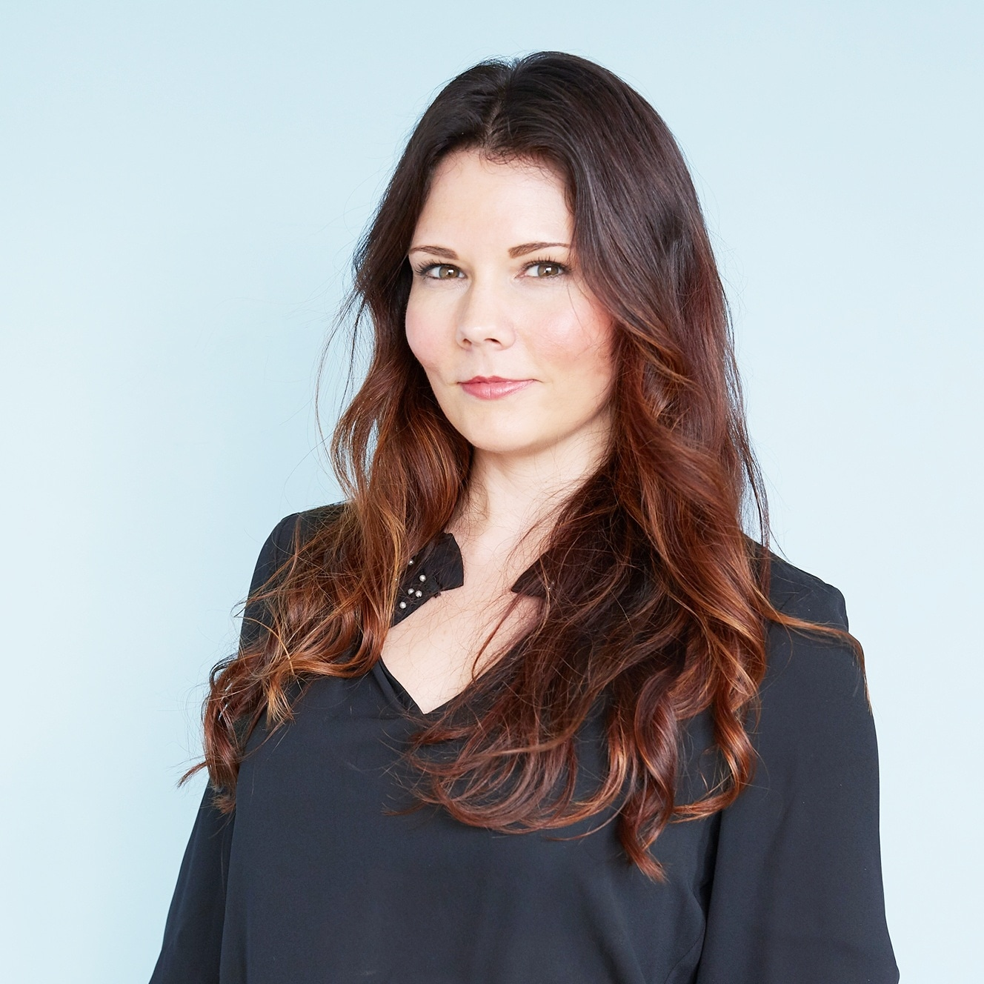

Guest Experts for Class 7: Connected and Autonomous Vehicles (CAVs)
Chelsey Colbert
Policy Counsel, Mobility & Location Data, Future of Privacy Forum
Bryant Walker Smith
Associate Professor of Law and Engineering at the University of South Carolina and Co-Director of the Project on Law and Mobility at the University of Michigan

Slide 5

Primer on Automated Driving and Connected Driving
Bryant Walker Smith
Associate Professor University of South Carolina School of Law and (by courtesy) School of Engineering
Affiliate Scholar Center for Internet and Society at Stanford Law School
Codirector Program on Law and Mobility at University of Michigan Law School

Slide 6
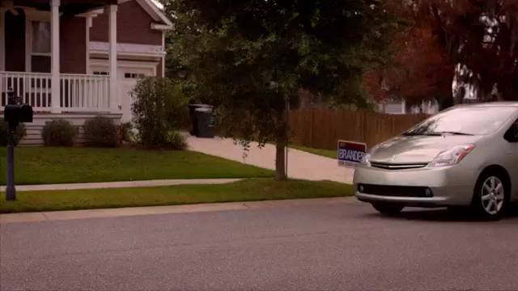

Slide 7
“Driverless remote-controlled cars”?
Driver assistance
Automated driving
Remote driving
Connected driving

Slide 8
Increasing automation and connectivity
Driver assistance
Automated driving
Remote driving
Connected driving

Slide 9
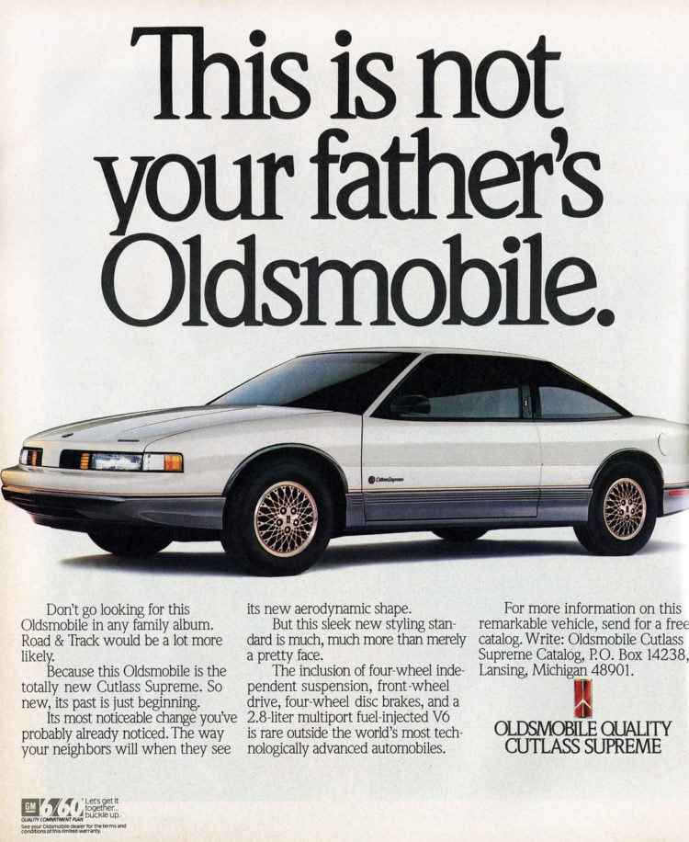
clickamericana.com/topics/culture-and-lifestyle/cars-trucks/1989-oldsmobile-cutlass-supreme-cutlass-calais

Slide 10

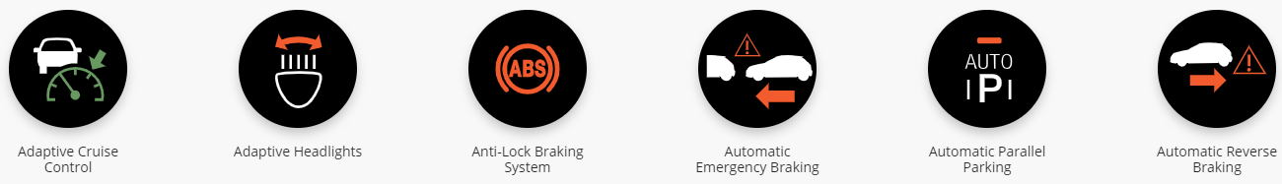
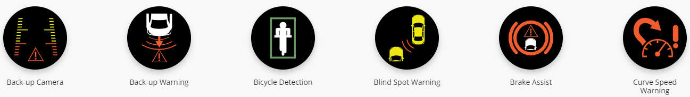

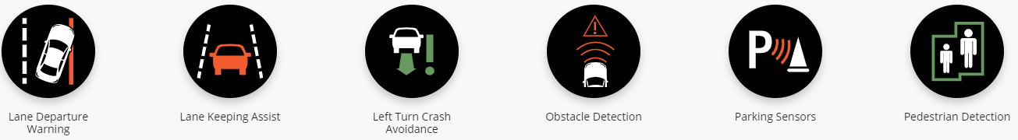

mycardoeswhat.org

Slide 11

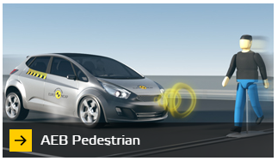
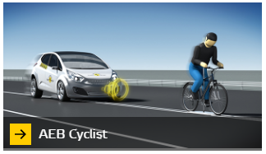
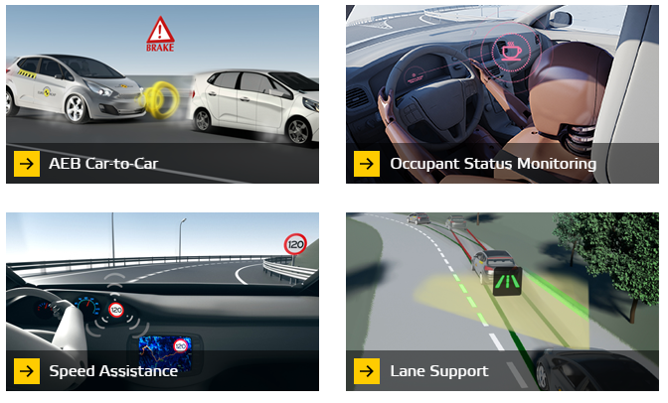

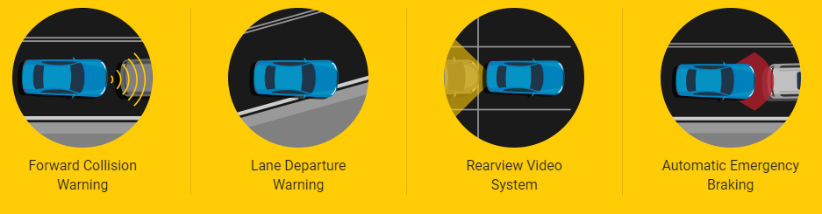

euroncamp.com; nhtsa.gov/ratings

Slide 12
What do we call all these?
Advanced driver assistance systems (ADAS)
Active safety systems
Driver support features
Automated emergency intervention systems (AEIS)

Slide 13
Driving (“performing the dynamic driving task”)*
Driving involves paying attention to the vehicle, the road, and the environment so you can steer, brake, accelerate, and communicate as needed
If you’re expected to pay attention, you’re still driving — even when a feature is assisting you with steering, braking, accelerating, and/or communicating
Driving may have an even broader legal meaning
*SAE J3016
newlypossible.org/wiki/index.php?title=Automated_Driving_Definitions
futurist.law.umich.edu/how-reporters-can-evaluate-automated-driving-announcements

Slide 14
SAE J3016 (and soon-to-be ISO PAS 22736)
Widely adopted industry document
Key definitions for driving automation
Levels of driving automation (L0 - L5)
Driver assistance / driver support (L0 - L2)
Automated driving (L3 - L5)

Slide 15
Assisted driving features
L0: You’re driving
L1: You’re driving, but you’re assisted with either steering or speed
L2: You’re driving, but you’re assisted with both steering and speed
newlypossible.org/wiki/index.php?title=Automated_Driving_Definitions
futurist.law.umich.edu/how-reporters-can-evaluate-automated-driving-announcements

Slide 16
L2: You’re driving, but you’re assisted with both steering and speed
Adaptive cruise control plus lane-keeping assist
Automatic parking (speed and steering)
GM’s “Super Cruise”
Tesla’s “““Autopilot and Full Self-Driving Capability”””
cadillac.com/world-of-cadillac/innovation/super-cruise

Slide 17
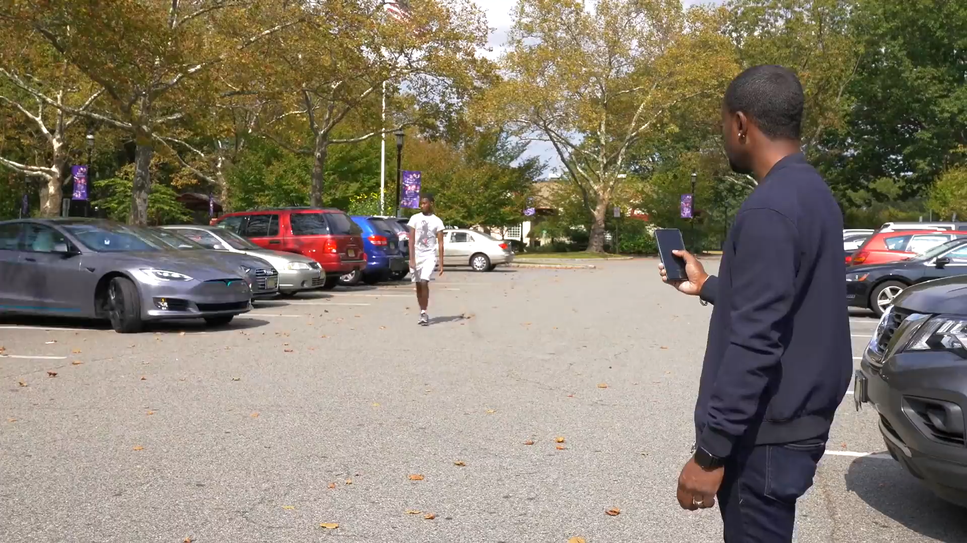
Tesla’s “Smart Summon”
youtu.be/enkRALcdPb0?t=364

Slide 18

Why is this still level 2?
If you’re expected to pay attention, you’re still driving — even when a feature is assisting you with steering, braking, accelerating, and/or communicating
youtu.be/enkRALcdPb0?t=364
newlypossible.org/wiki/index.php?title=Automated_Driving_Definitions
futurist.law.umich.edu/how-reporters-can-evaluate-automated-driving-announcements

Slide 19
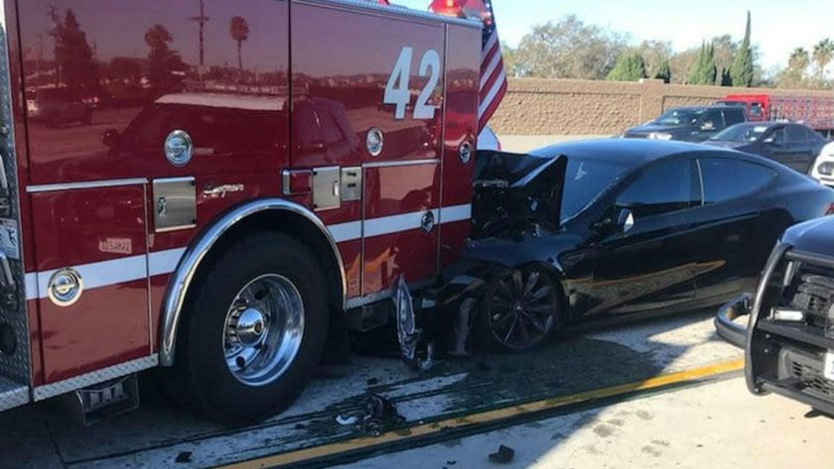
Driver assistance features work unless and until they don’t
Culver City Firefighters Local 1927 (via Associated Press)
NTSB Accident ID: HWY18FH004

Slide 20
Complemented by interior sensors
Occupancy/weight/seatbelt use: Many kinds (in all cars)
Inattention: Camera (GM Super Cruise)
Hands-on-wheel: Presence and torque (many cars)
Drowsiness: Steering angle and torque (many cars)
Intoxication: Alcohol detectors (aftermarket)
Break-ins: Camera (Tesla?)
Gestures: Camera (Bosch)
Crash assessment: Microphone (OnStar)
And more!

Slide 21
Increasing automation and connectivity
Driver assistance
Automated driving
Remote driving
Connected driving

Slide 22
Increasing automation and connectivity
Driver assistance
Automated driving
Remote driving
Connected driving

Slide 23
Automated driving (SAE L3 - L5)
Autonomous
Driverless
Self-driving
A shibboleth in the technical world
A (mostly) neutral and inclusive term

Slide 24
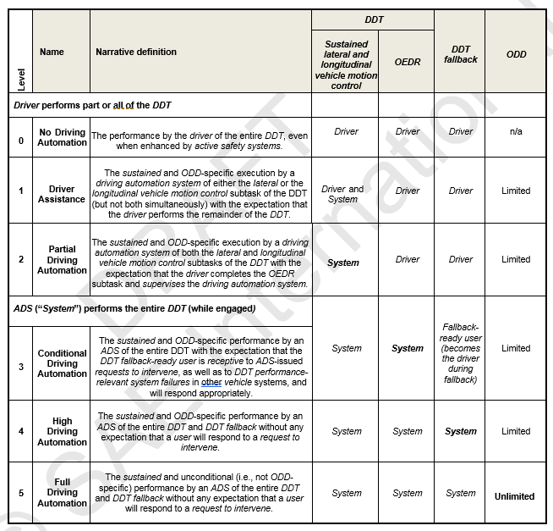

Slide 25
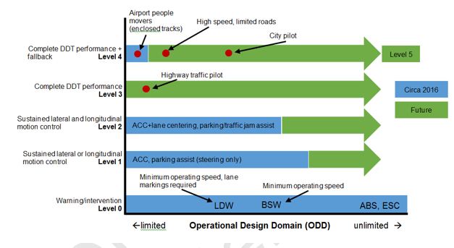

Slide 26
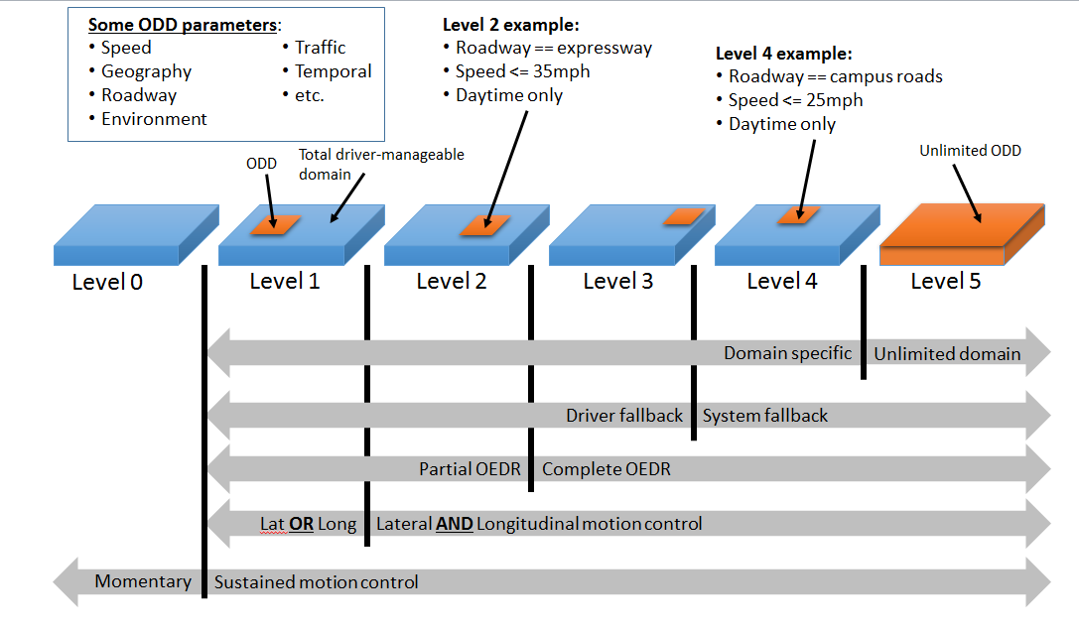

Slide 27
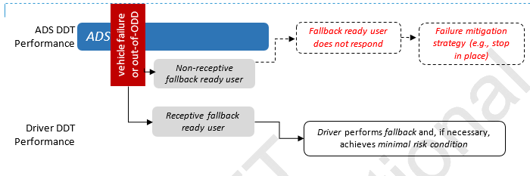

Slide 28
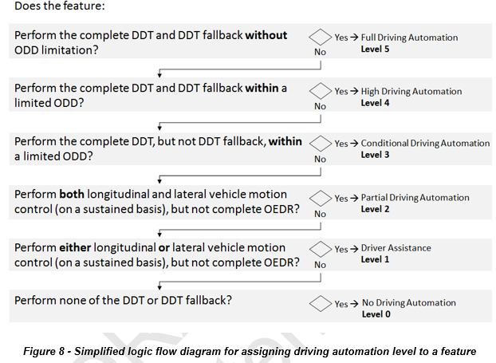

Slide 30
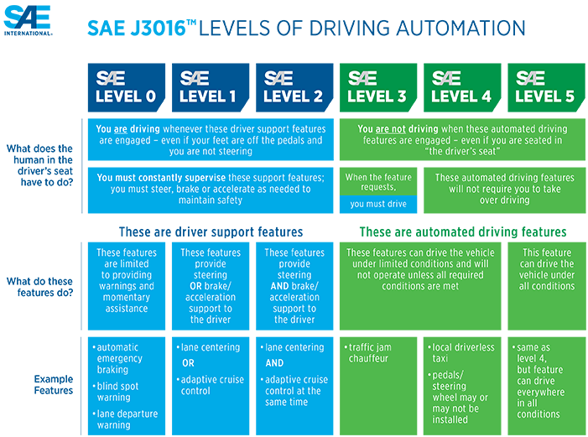
sae.org/standards/content/j3016_201806/

Slide 31
“Drive means to drive, operate, move, or be in actual physical control of a vehicle…”
“Operate … means to drive…”
“Operating … is generally given a broader meaning [than driving]”
Maryland Transp Code § 11-114, 141 (2016)
McDuell v. State, 231 A.2d 265, 267 (Del. 1967)
Bryant Walker Smith, Automated Driving Is Probably Legal in the United States (newlypossible.org)

Slide 32
Assisted driving features
L0: You’re driving
L1: You’re driving, but you’re assisted with either steering or speed
L2: You’re driving, but you’re assisted with both steering and speed
newlypossible.org/wiki/index.php?title=Automated_Driving_Definitions
futurist.law.umich.edu/how-reporters-can-evaluate-automated-driving-announcements

Slide 33
Automated driving features
L3: You’re not driving, but you will need to drive if prompted in order to maintain safety
L4: You’re not driving, but either
you will need to drive if prompted in order to reach your destination (in a vehicle you can drive) or
you will not be able to reach every destination (in a vehicle you can’t drive)
L5: You’re not driving, and you can reach any destination
newlypossible.org/wiki/index.php?title=Automated_Driving_Definitions
futurist.law.umich.edu/how-reporters-can-evaluate-automated-driving-announcements

Slide 34
ADS
Automated Driving System
“vehicle equipped with an (engaged) automated driving system”
Automated Vehicle (AV)

Slide 35


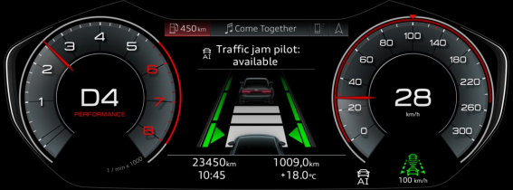
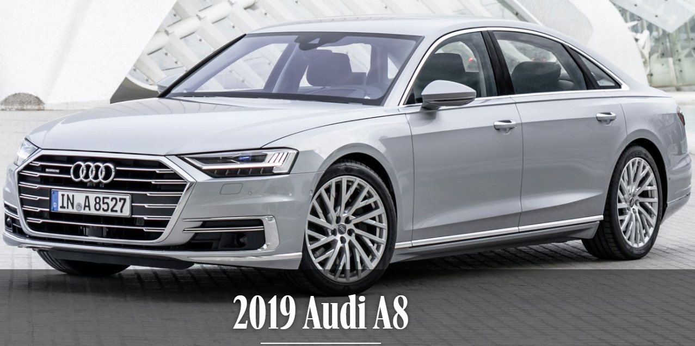

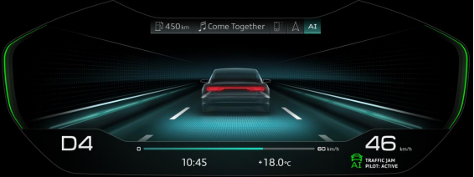
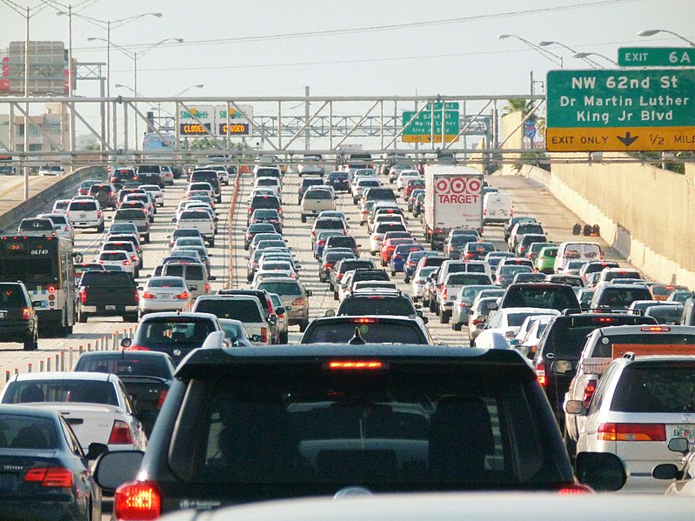
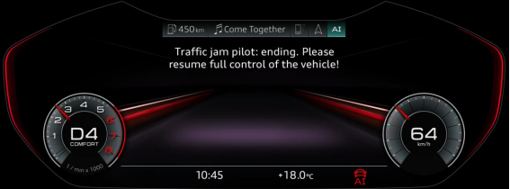
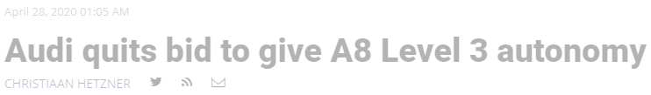
L3: You’re not driving, but you will need to drive if prompted in order to maintain safety
By B137, CC BY-SA 4.0, https://commons.wikimedia.org/w/index.php?curid=48998674
Audi press release (August 2017); europe.autonews.com/automakers/audi-quits-bid-give-a8-level-3-autonomy

Slide 36


L3: You’re not driving, but you will need to drive if prompted in order to maintain safety

Slide 37
L4: You’re not driving, but either:
a) you will need to drive if prompted in order to reach your destination (in a vehicle you can drive)….

Slide 38
L4: You’re not driving, but either:
a) you will need to drive if prompted in order to reach your destination (in a vehicle you can drive)….
Pulling over on shoulder = minimal risk condition (…)

Slide 39
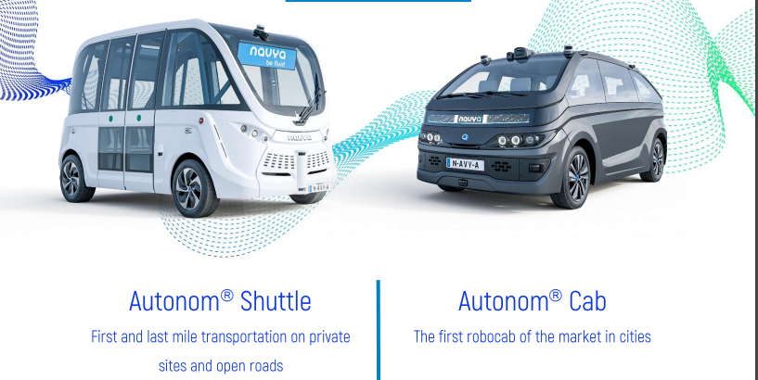
L4: … or you will not be able to reach every destination (in a vehicle you can’t drive)
navya.tech/wp-content/uploads/2019/01/NAVYA-Safety-Report-01.09.2019-1.pdf

Slide 40


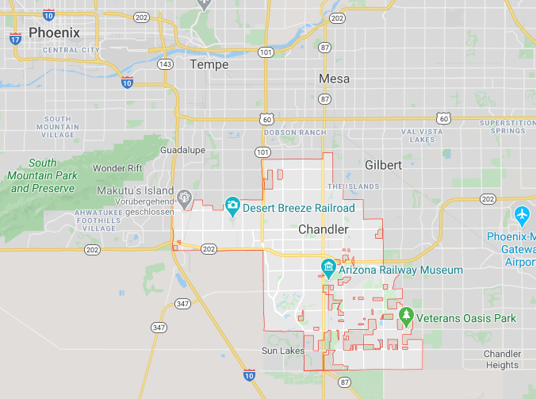

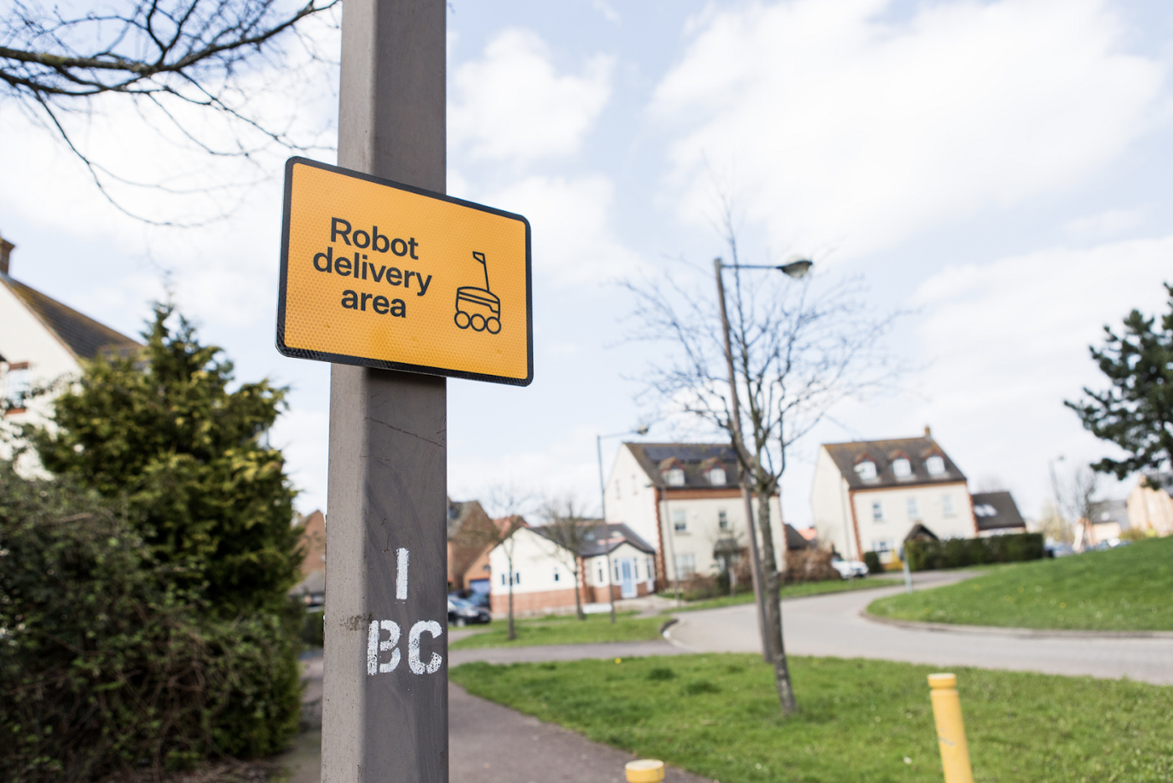
Operational design domain (ODD)
When and where a feature is specifically designed to function
Google Maps; Straßenverkehrsordnung, commons.wikimedia.org/w/index.php?curid=49947; miro.medium.com/max/1400/0*9MQQpiBhfRaPZhra

Slide 41

L5: You’re not driving, and you can reach any destination (an “unlimited” ODD…)
By Dante Gabriel Rossetti, Public Domain, https://commons.wikimedia.org/w/index.php?curid=44841386

Slide 42


Vehicle types
Vehicles you can drive:
Vehicles you can’t drive:

Slide 43
Trip types
You must drive for the entire trip (L0 - L2)
You will need to drive if prompted in order to maintain safety (L3)
You will need to drive if prompted in order to reach your destination (L4)
You will not need to drive for any reason, but you may drive if you want (L4 - L5)
You will not need to drive for any reason, and you may not drive (L4 - L5)

Slide 44
What’s driving today?
You cannot buy an AV
You might be able to ride in an aspirational AV
You might be able to use a delivery robot
But they will almost certainly be supervised

Slide 45
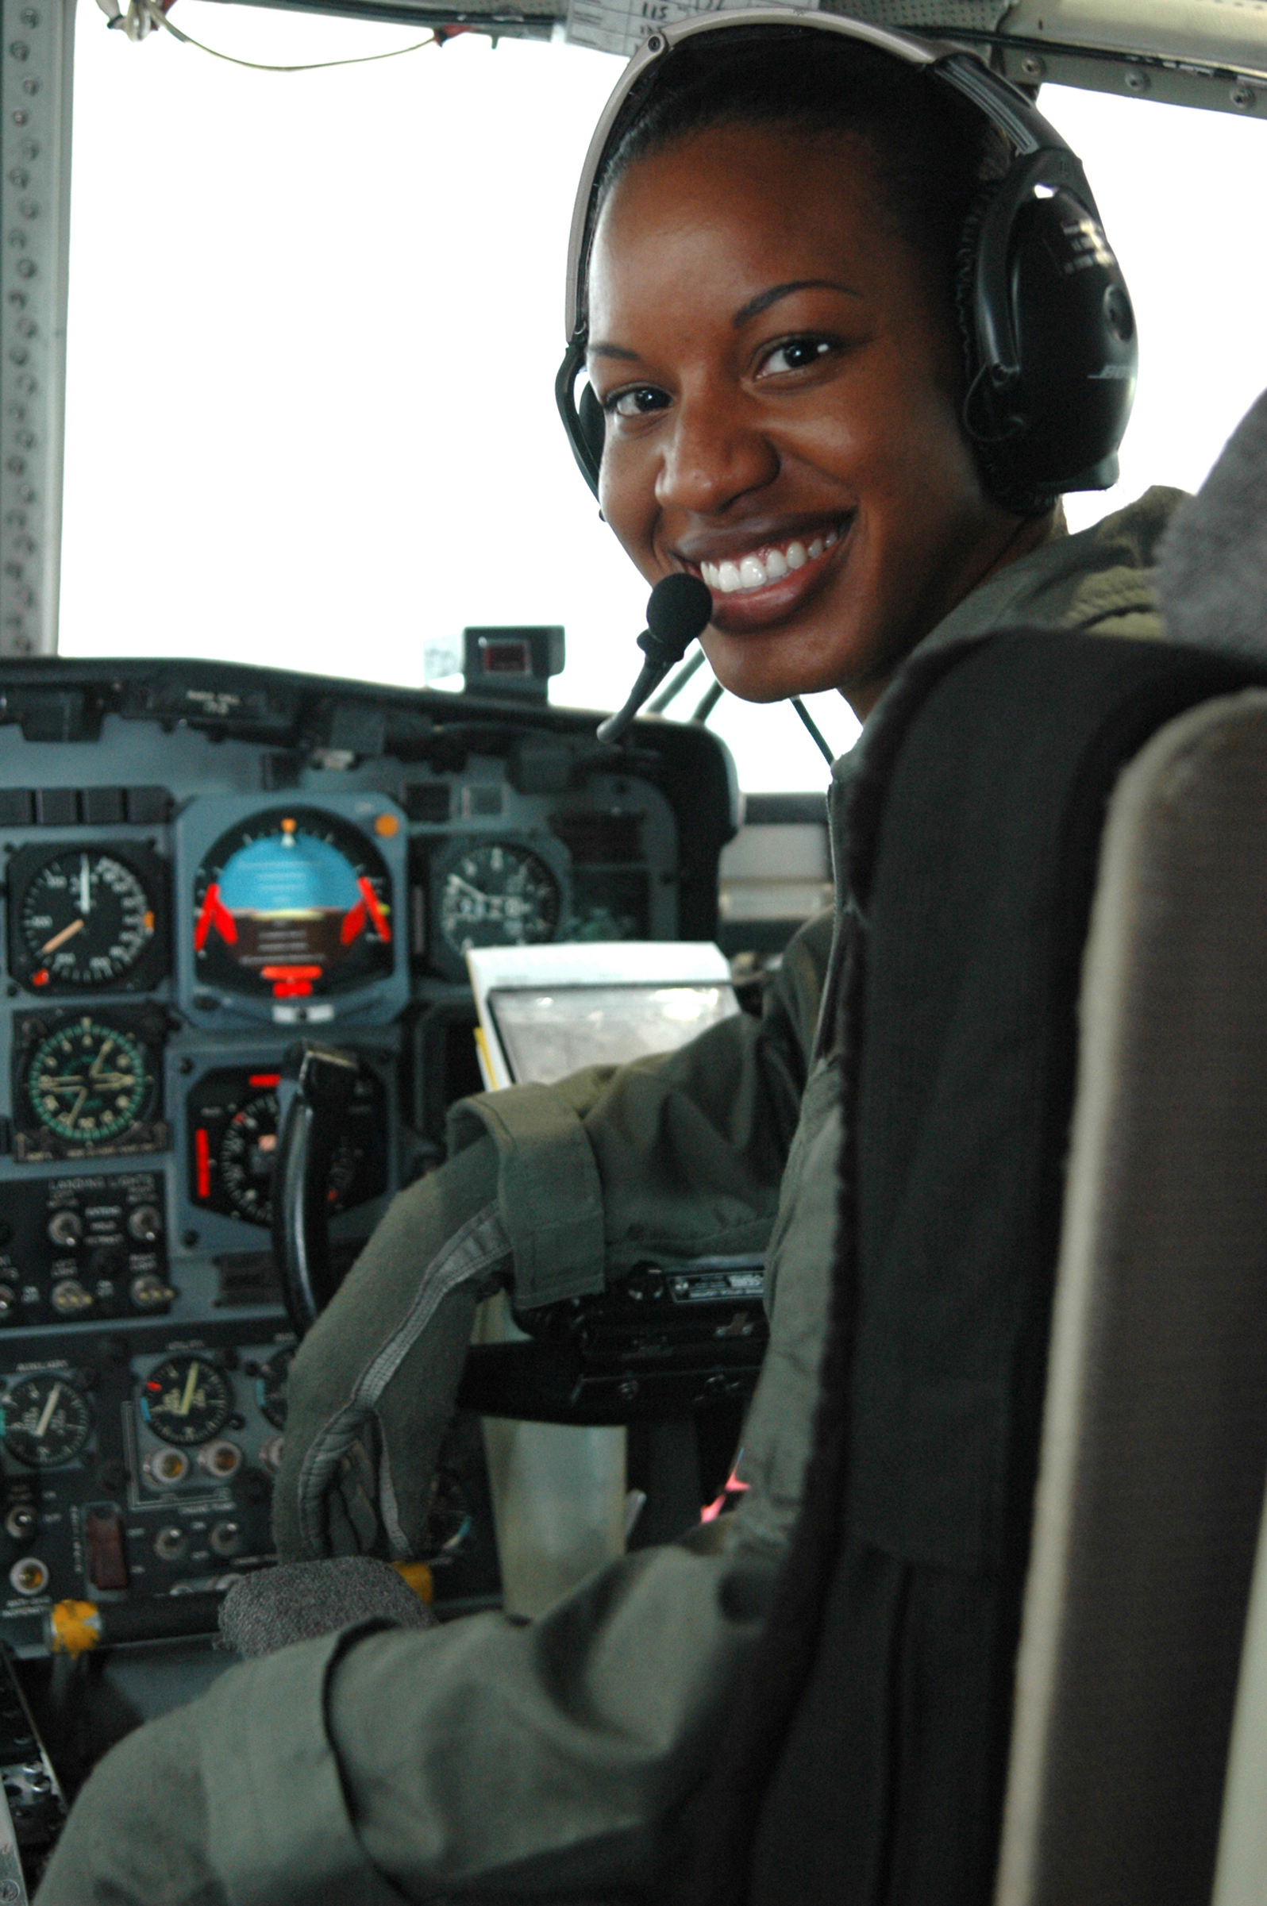
Lt. Jeanine Menze by PO2 Jennifer Johnson, alaska.coastguard.dodlive.mil/2014/03/breaking-barriers-and-becoming-the-change-for-women-in-coast-guard-aviation/

Slide 46
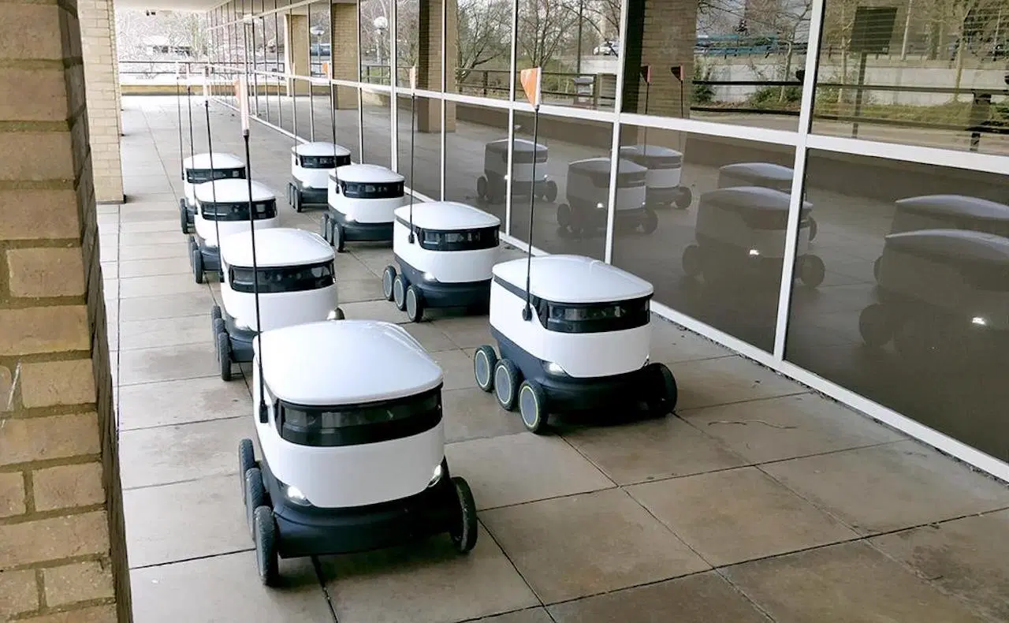

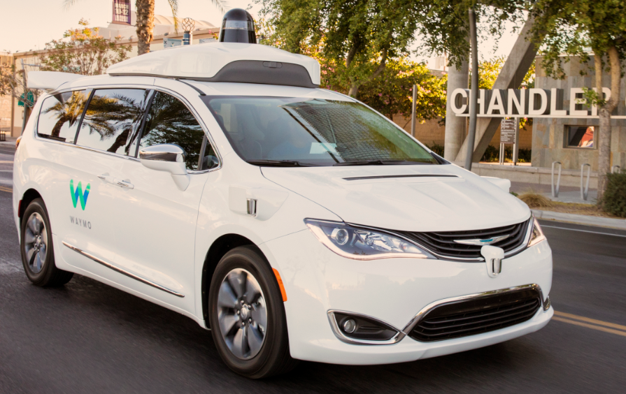

starship.xyz; waymo.com

Slide 47
Looking ahead
Some combination of:
Slow speeds
Simple environments
Supervised operations
3-S

Slide 48
Increasing automation and connectivity
Driver assistance
Automated driving
Remote driving
Connected driving

Slide 49
Increasing automation and connectivity
Driver assistance
Automated driving
Remote driving
Connected driving

Slide 50
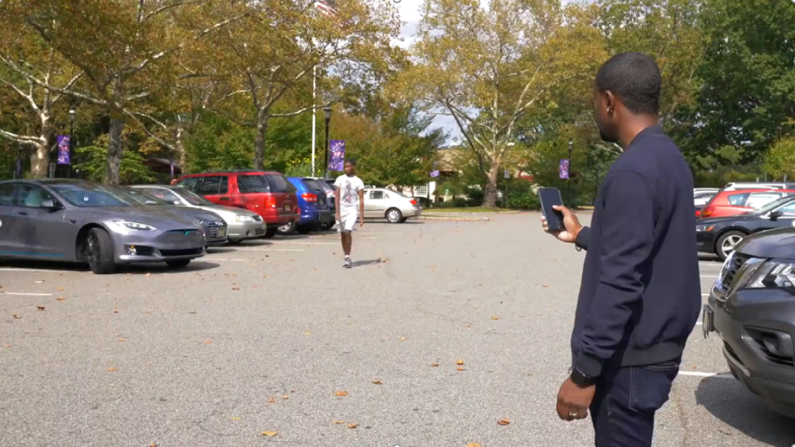
Tesla’s “Smart Summon”
youtu.be/enkRALcdPb0?t=364

Slide 51
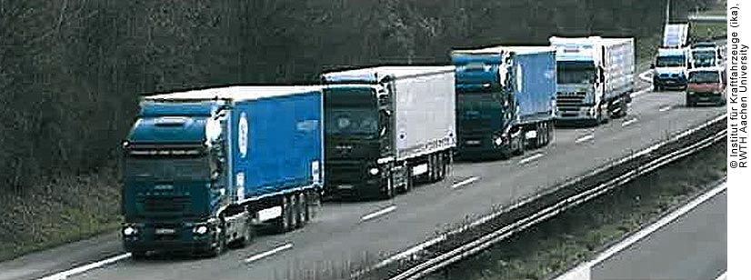
Platooning
www.fhwa.dot.gov/publications/research/ear/12033/004.cfm

Slide 52
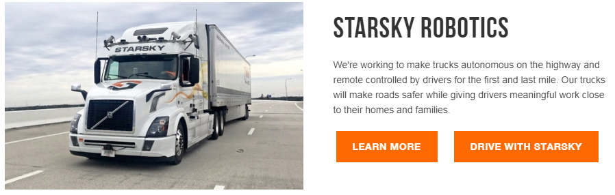
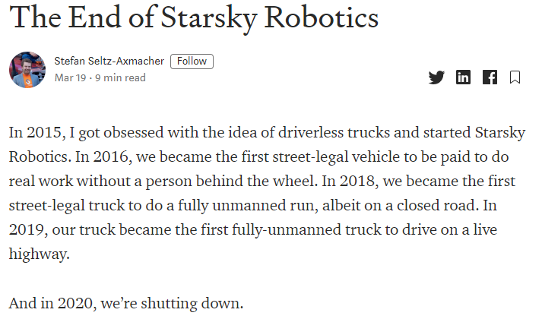
Really remote driving
www.starsky.io; medium.com/starsky-robotics-blog/the-end-of-starsky-robotics-acb8a6a8a5f5

Slide 53

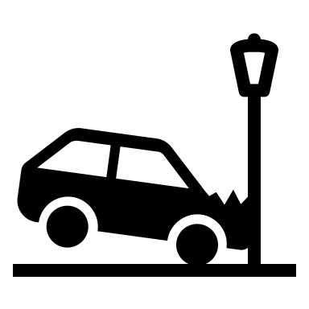
Pop quiz!
On reaching a crash site, an automated vehicle stops in its lane until someone at a faraway monitoring center sketches a travel path. Using its sensors, the vehicle then follows this path.

Slide 54
Pop quiz!
On reaching a crash site, an automated vehicle stops in its lane until someone at a faraway monitoring center sketches a travel path. Using its sensors, the vehicle then follows this path.
1) Is this L3 or L4 automated driving?
2) Is there a remote driver?

Slide 55
Pop quiz!
1) Is this L3 or L4 automated driving?
Is standing in this lane a minimal risk condition?

Slide 56
Pop quiz!
2) Is there a remote driver?
Is the remote agent (a) “performing the dynamic driving task” or (b) merely providing additional information for the automated driving system?

Slide 57
Increasing automation and connectivity
Driver assistance
Automated driving
Remote driving
Connected driving

Slide 58
Increasing automation and connectivity
Driver assistance
Automated driving
Remote driving
Connected driving

Slide 59

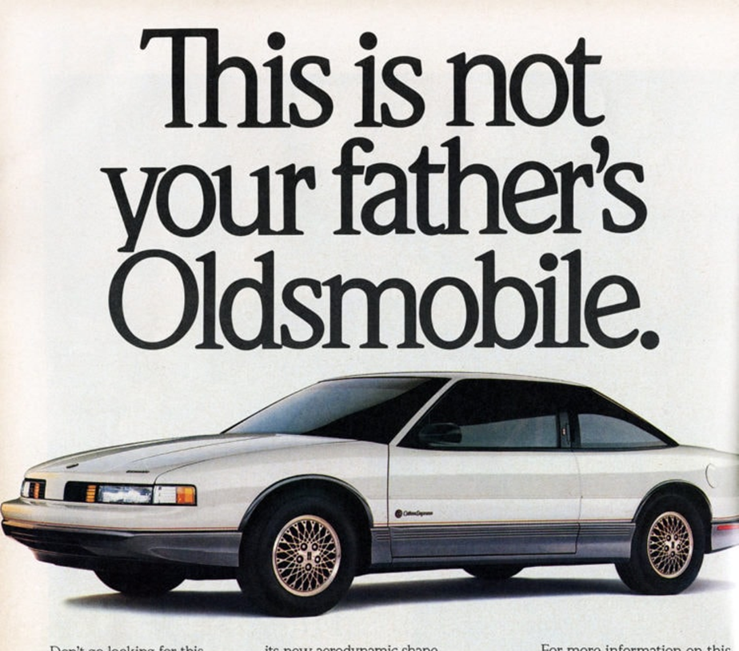
Automation versus connectivity
L5 ADS
Increasing automation
V2X
Increasing connectivity
clickamericana.com/topics/culture-and-lifestyle/cars-trucks/1989-oldsmobile-cutlass-supreme-cutlass-Calais
freesvg.org/unicorn-vector-clipart-pdv

Slide 60
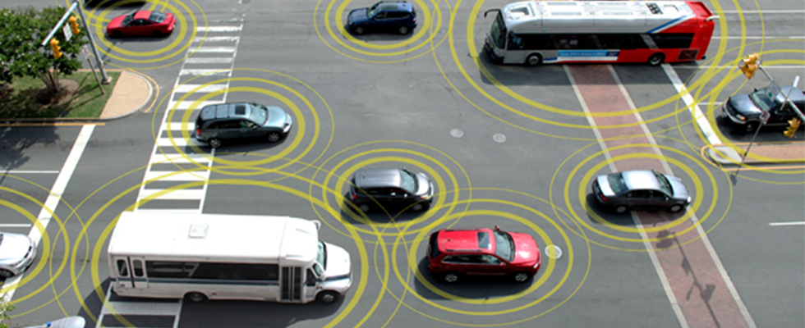
Communications
V2V: Vehicle-to-Vehicle
V2P: Vehicle-to-Pedestrian
V2I: Vehicle-to-Infrastructure
V2C: Vehicle-to-Cloud
V2D: Vehicle-to-Device
V2X: Vehicle-to-Everything
transportation.gov/content/us-dot-advances-deployment-connected-vehicle-technology-prevent-hundreds-thousands-crashes-0. But really: This image is everywhere. Everywhere. Back in the day, no briefing on V2V was complete without it. I think people started expecting that cars of the future would shoot golden halos. So does anybody actually know where this image originally came from? Or does it have a kind of transcendent always-has-and-always-will-be permanence, much like those mysterious golden halos?

Slide 61
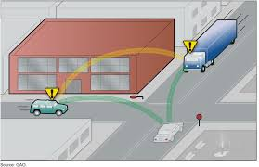
A narrow version of vehicle connectivity
Direct communication to/from vehicles
Really fast (“low latency”) and super reliable
Supports safety-critical applications
nhtsa.gov/staticfiles/rulemaking/pdf/V2V/Readiness-of-V2V-Technology-for-Application-812014.pdf

Slide 62
Basic safety message (BSM) in US*
Ten times a second: “Hey there vehicle neighbors! My temporary pseudonym is BigSister389. I’m a 15-ft-long vehicle at 34°/81°/300ft moving NW at 30mph but slowing at 15fps with my steering wheel at 15° and my brakes engaged….”
Every few seconds: “And by the way, it’s 32° outside, I think it’s raining, my lights and wipers are on, I weigh 3000lbs, and here’s some other fun trivia that you might find safety-relevant…oh, but first, watch out for the black ice!”
*The EU’s cooperative awareness message is vaguely similar….
SAE J2735 (but supremely stylized)

Slide 63
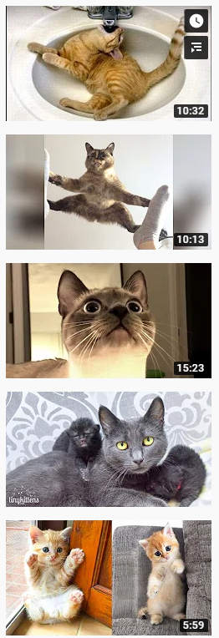
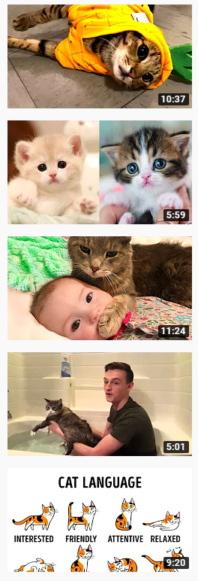
Devil in the details
Competing technologies
DSRC/ITS G5/802.11p (Wi-Fi)
C-V2X LTE & 5G (Cellular)
Spectrum (re)allocation and spectrum sharing
Slooooow adoption
Regional differences and incompatibilities
youtube.com, but please don’t go there now; the cat videos will still be there when this is done

Slide 64
Few and (literally) far between
DSRC/ITS G5 | C-V2X
Some Cadillacs since 2017 | All Fords from 2022?
Some VW Golfs from 2020
All US Toyotas from 2021?
Some cars in Japan since 2016
To be mandated in US (2018) | Preferred in China
Preferred in EU (2019)
EU to be “technology neutral” (2019)

Slide 65
Automation versus connectivity
L5 ADS
Increasing automation
V2X
Increasing connectivity
clickamericana.com/topics/culture-and-lifestyle/cars-trucks/1989-oldsmobile-cutlass-supreme-cutlass-Calais
freesvg.org/unicorn-vector-clipart-pdv

Slide 66
A broad version of vehicle connectivity
Telematics
Infotainment
OBD II dongles
In-vehicle Wi-Fi
In-vehicle Bluetooth
Mobile vehicle apps
Over-the-air updates
OnStar (and its competitors)

Slide 67
A broad version of vehicle connectivity
All this is here now
Telematics
Infotainment
OBD II dongles
In-vehicle Wi-Fi
In-vehicle Bluetooth
Mobile vehicle apps
Over-the-air updates
OnStar (and its competitors)
(and has been for years)

Slide 68
Automation versus connectivity
L5 ADS
Increasing automation
V2X
Increasing connectivity
clickamericana.com/topics/culture-and-lifestyle/cars-trucks/1989-oldsmobile-cutlass-supreme-cutlass-Calais
freesvg.org/unicorn-vector-clipart-pdv

Slide 69
Key questions for a data discussion
(How) are mobile phones and other connected devices different than motor vehicles?
(How) are V2V-capable motor vehicles different than conventional motor vehicles?
(How) are automated vehicles different than conventional motor vehicles?

Slide 70
Increasing automation and connectivity
Driver assistance
Automated driving
Remote driving
Connected driving

Slide 71
Increasing automation and connectivity
Driver assistance
Automated driving
Remote driving
Connected driving

Slide 72
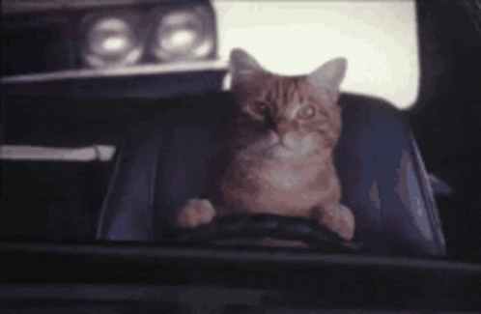
END PART ONE
BEGIN PART TWO
tenor.com/view/adam-workaholics-way-to-work-cat-driving-gif-16820165. As promised

Slide 73
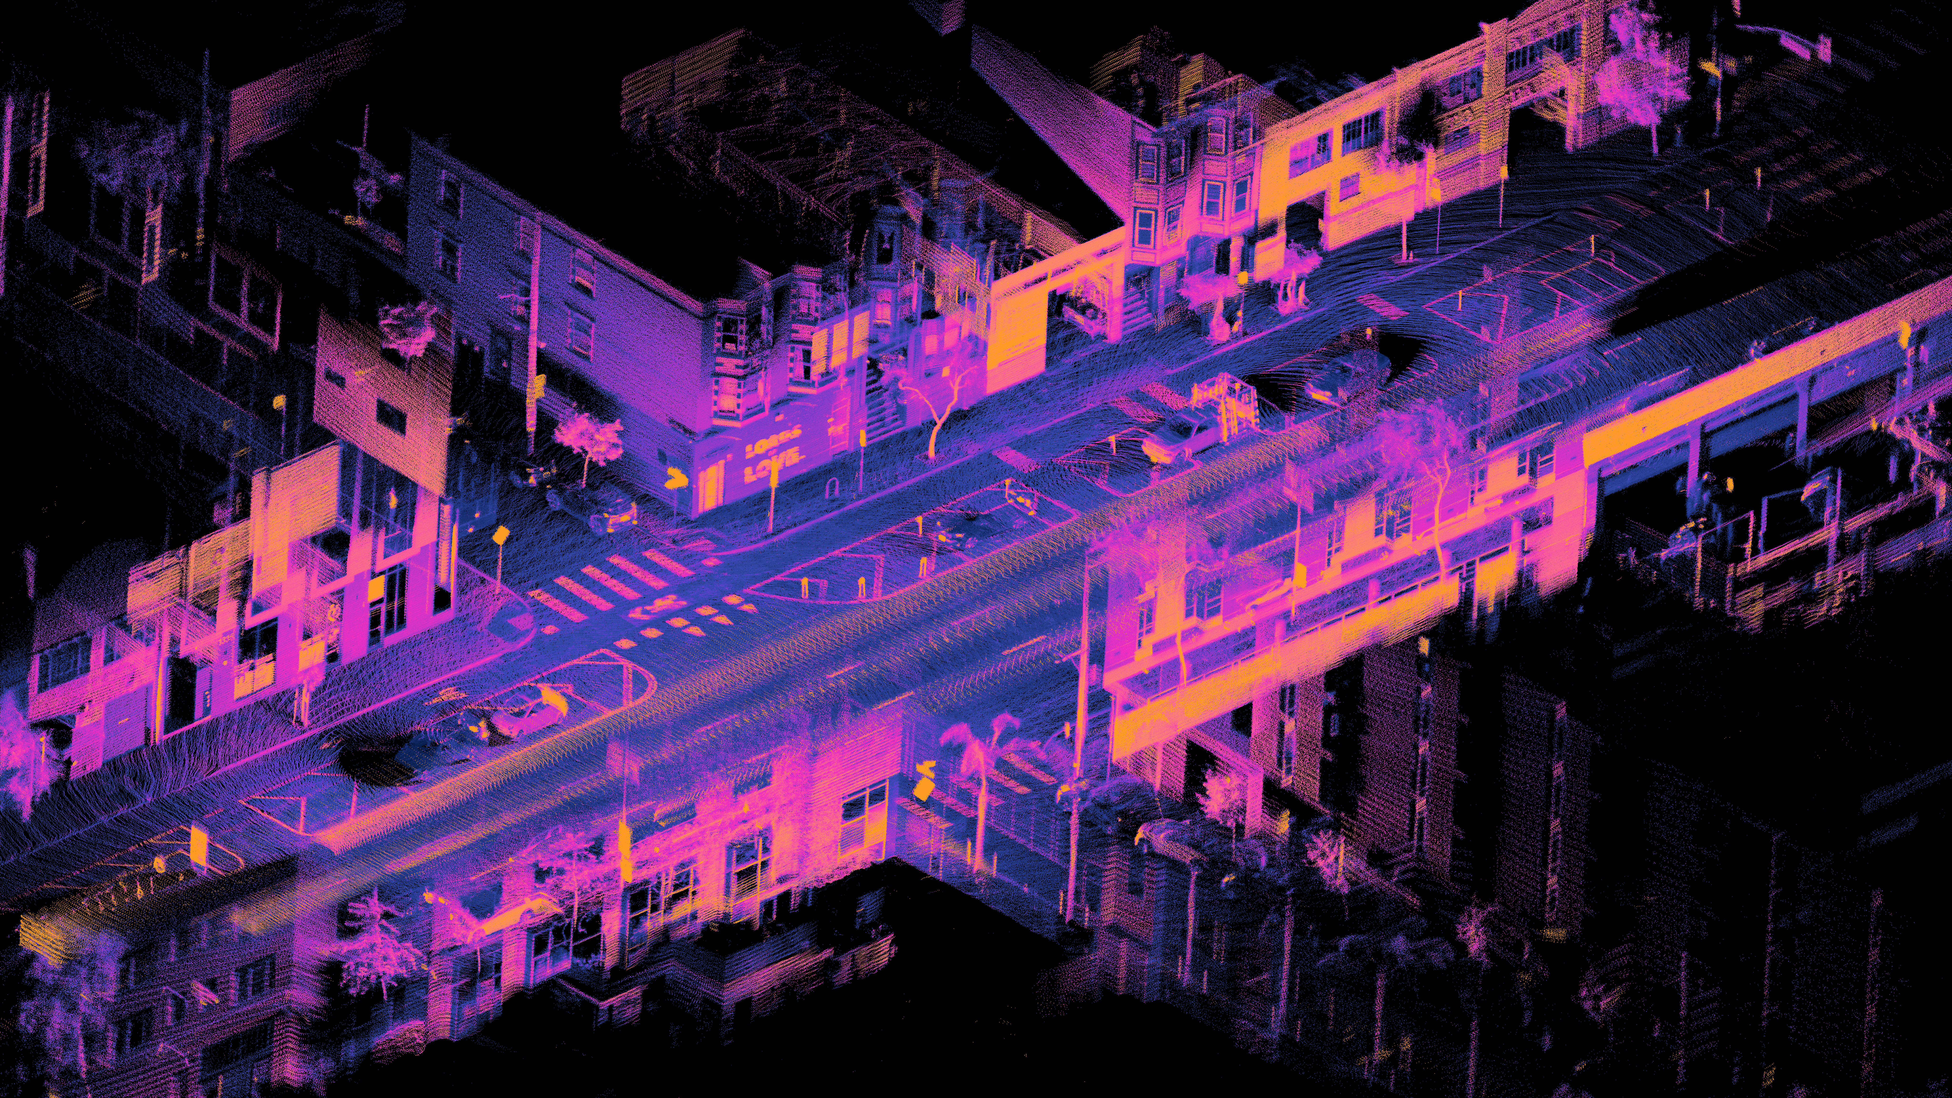
Automated Driving Technologies and Data
Daniel L. Lu, CC BY 4.0, en.wikipedia.org/wiki/File:Ouster_OS1-64_lidar_point_cloud_of_intersection_of_Folsom_and_Dore_St,_San_Francisco.png

Slide 74
Increasing automation and connectivity
Driver assistance
Automated driving
Remote driving
Connected driving

Slide 75
How the technologies work
Driver assistance
Automated driving
Remote driving
Connected driving

Slide 76
Automated driving is a wide range of
Underlying technologies
Applications of those technologies
Business cases for those applications
Participants in those business cases

Slide 77
Driving (“performing the dynamic driving task”)*
Driving involves paying attention to the vehicle, the road, and the environment so you can steer, brake, accelerate, and communicate as needed
If you’re expected to pay attention, you’re still driving — even when a feature is assisting you with steering, braking, accelerating, and/or communicating
Driving may have an even broader legal meaning
*SAE J3016
newlypossible.org/wiki/index.php?title=Automated_Driving_Definitions
futurist.law.umich.edu/how-reporters-can-evaluate-automated-driving-announcements

Slide 78
Driving
What’s around me?
What should I do?
I’m doing it!
…

Slide 79
Driving
What’s around me? Perception
What should I do? [Path] Planning
I’m doing it! Actuation
…

Slide 80
Driving
Data and privacy
What’s around me? Perception
What should I do? [Path] Planning
I’m doing it! Actuation
…

Slide 81
Some of Waymo’s external sensors
Cameras
LiDAR
RADAR
LiDAR
RADAR
LiDAR
LiDAR
Plus microphones, ultrasonic sensors, inertial sensors, and GPS receivers (but not DSRC receivers)
As well as numerous internal sensors
waymo.com

Slide 82
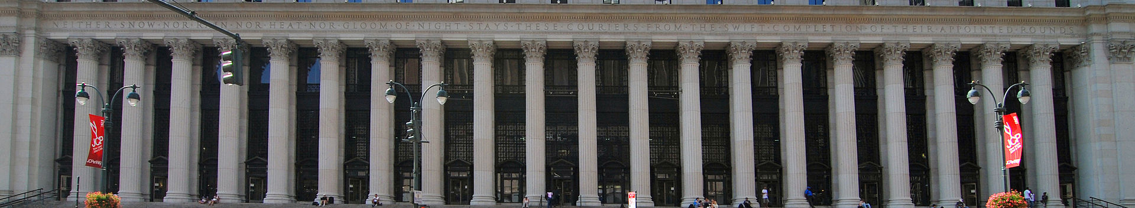
Why so many?
Inches away to hundreds of feet away
Day and night, sunrise and sunset….
Snow, rain, fog, glare....
Distance, size, color, detail….
Accuracy, reliability, and confidence
CC BY-SA 3.0, https://commons.wikimedia.org/w/index.php?curid=9445545. Bonus points if you know this building!

Slide 83
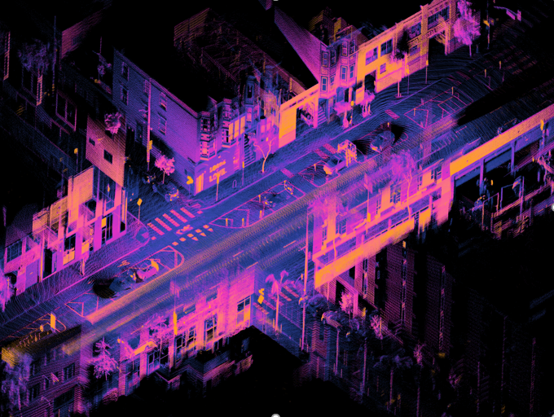
Sensors and mapping: What do I expect?
Beforehand: Build a highly detailed 3D map
During: Compare the map to the real world
Where am I?
What’s different?
What has changed?
What is there to see?
Afterward: Update the map
(unless you’re Tesla)
Daniel L. Lu, CC BY 4.0, en.wikipedia.org/wiki/File:Ouster_OS1-64_lidar_point_cloud_of_intersection_of_Folsom_and_Dore_St,_San_Francisco.png

Slide 84

Sensors and “objects”: What do I see?
Detect, classify, and track people walking, people running, people biking, people walking bikes, people walking in crowds, people trying to cross, buses, cars, motorcycles, scooters, trucks, trucks pulling cars, cars pulling trucks, trailers, cats, dogs, birds, turtles, snakes, alligators, deer, elk, police cars, ambulances, firetrucks, garbage trucks, construction equipment, construction detours, first responders, crossing guards, temporary traffic signals, new traffic signs, potholes, mattresses, plastic bags, shredded tires, trees, tree limbs, shadows, hanging wires, low-flying planes, marathons, towtrucks, towtrucks towing other towtrucks, cars backing up, cars going the wrong way, cars upside down, millions of other things we’ve seen before and millions of things that we haven’t…
…and then predict what they’ll do next
www.publicdomainpictures.net/en/view-image.php?image=243334&picture=kangaroo-crossing-sign

Slide 85
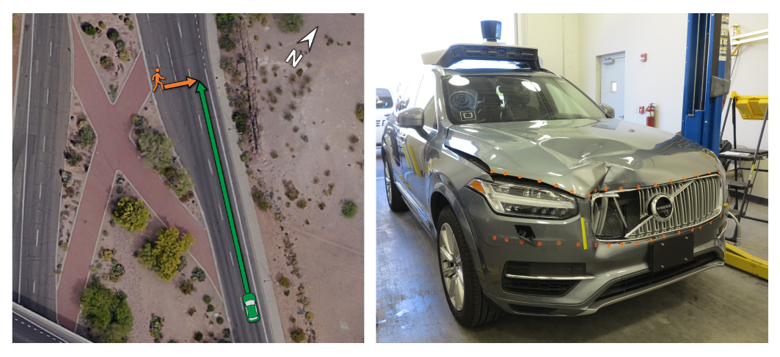
Example: Uber’s fatal crash
ntsb.gov/investigations/AccidentReports/Pages/HWY18MH010-prelim.aspx

Slide 86
Example: Uber’s fatal crash
Volvo’s emergency braking system disabled in favor of Uber’s human and machine system
6 sec before impact: Software is unsure about classification and path (unknown object / vehicle / bicycle) and so does nothing
1.3 sec before impact: Software anticipates collision and so does nothing
< 1 sec before impact: Human driver finally intervenes
ntsb.gov/investigations/AccidentReports/Pages/HWY18MH010-prelim.aspx

Slide 87
Example: Uber’s fatal crash
Believing the safety driver will be careful, Uber’s engineers create a vehicle that behaves recklessly
Believing the vehicle will be careful, Uber’s safety driver behaves recklessly
A woman dies
ntsb.gov/investigations/AccidentReports/Pages/HWY18MH010-prelim.aspx

Slide 88
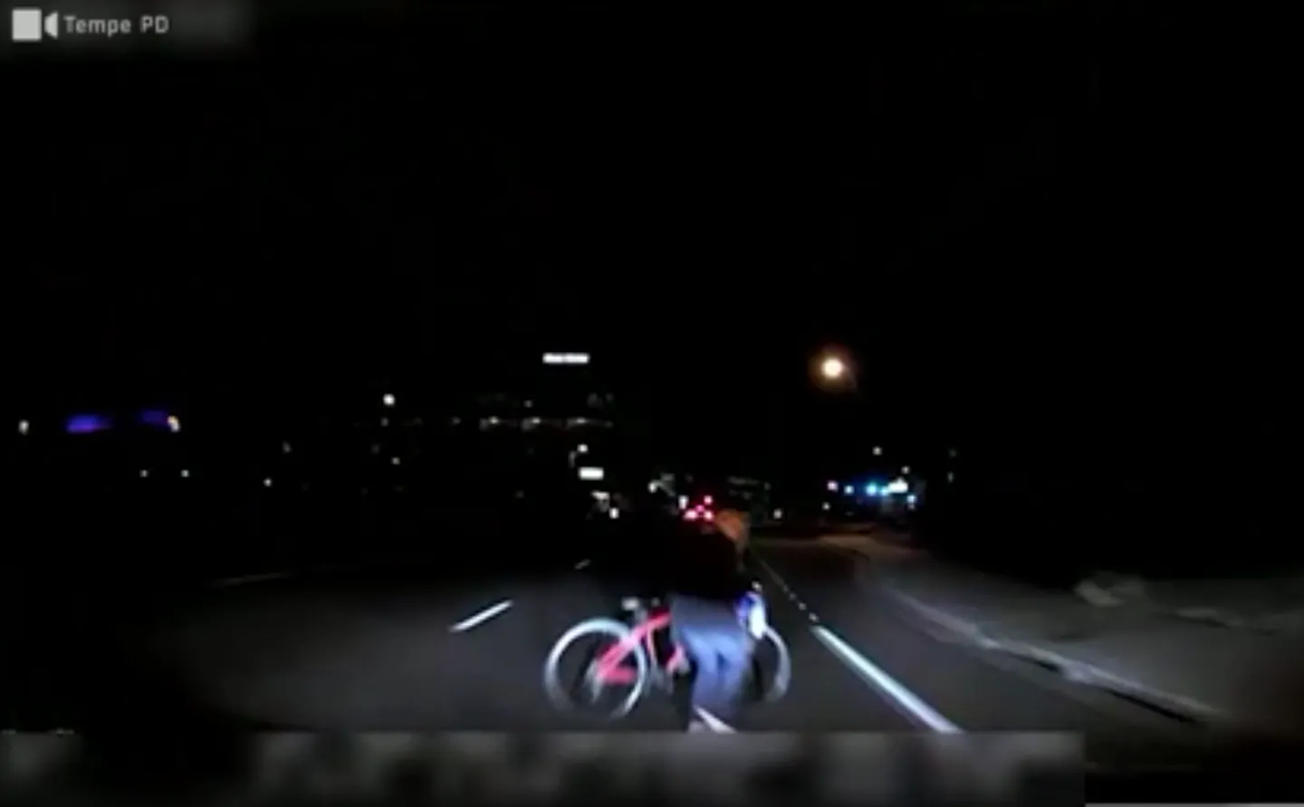
This failure is unacceptable

Slide 89
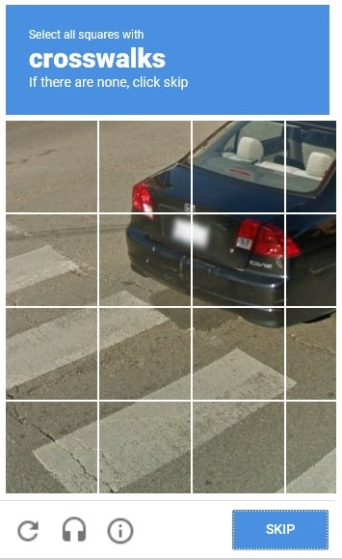
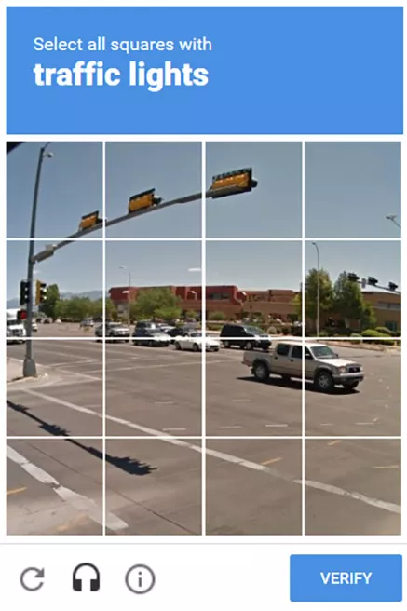
You’re helping
learn.g2.com/captcha; wingarc.com.au/2019/09/is-google-using-us-to-train-self-driving-cars

Slide 90
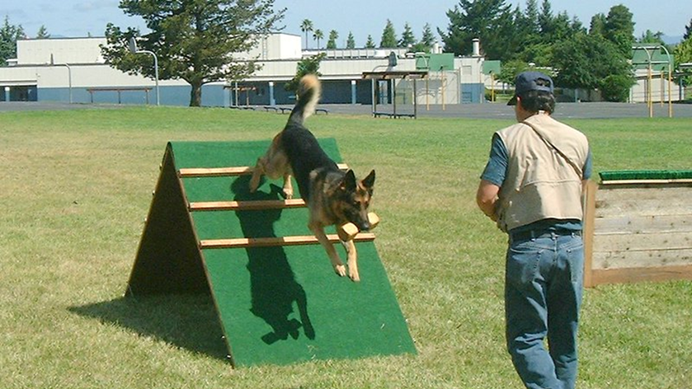

Machine learning
Supervised
Unsupervised
CC BY-SA 3.0, wikipedia.org/w/index.php?curid=2508139; www.youtube.com/watch?v=BxODSKCN00k

Slide 91

Like a thesaurus
www.thesaurus.com/browse/privacy

Slide 92
Increasing automation and connectivity
Some systems use machine learning techniques
Driver assistance
Automated driving
Remote driving
Connected driving
All systems will use machine learning techniques

Slide 93
Stylized Data Pathways
Generated/ Received
Processed
Used
Stored
Transmitted
Processed
Stored
Used
Shared
Offboard (Cloud)
Onboard (Vehicle)
Discarded
Stored
Used
Shared
Transmitted
A giant meaningless number
Terabytes/ hours?*
Terabytes/ hour?*
* Equivalent to a large home hard drive with millions of photos or hundreds of thousands of songs

Slide 94
Automated driving data
To operate the system (implicit)
To develop the system (implicit/intended)
To document performance (intended)
During operation of the system (incidental)

Slide 95
Inside the vehicle
The vehicle
Outside the vehicle

Slide 96



Unimaginable possibilities?
www.american-rails.com/baltimore.html; germanyiswunderbar.com/northern-germany/germany-holidays-the-kiel-canal;
By Yngvar - Own work, based on notes and recollections from 1974, Public Domain, commons.wikimedia.org/w/index.php?curid=1555388

Slide 97

Real-time Streetview?
Google Street View, cnet.com/pictures/crazy-images-caught-on-google-street-view/26/

Slide 98

Automated enforcement by private networks?
Rocksee, CC BY 2.0, www.flickr.com/photos/rocksee/2659679597

Slide 99


thedrive.com/tech/20102/can-big-automakers-be-trusted-with-big-data

Slide 101
Connected Car Data Flows

Slide 102




Regulatory Landscape

Slide 103
Data Protection by Design & by Default
Legal requirements in the GDPR
embedded safeguards and mechanisms throughout the lifecycle of the application, service or product
requires the Controller to implement appropriate technical and organizational measures
a risk-based approach that is contextual and dynamic
European Data Protection Board
Draft guidelines Guidelines 1/2020 on processing personal data in the context of connected vehicles and mobility related applications

Slide 104


Privacy by Design
Proactive not reactive; Preventative not remedial
Privacy as the default setting
Privacy embedded into design
Full functionality - Positive-sum, not zero-sum
End to end security - full lifecycle protection
Visibility and transparency - keep it open
Respect for user privacy - keep it user-centric

Slide 105

Example of PbD Practices with optical sensors and computer vision

Slide 106
Thank-you!
Questions?

