Slide 1
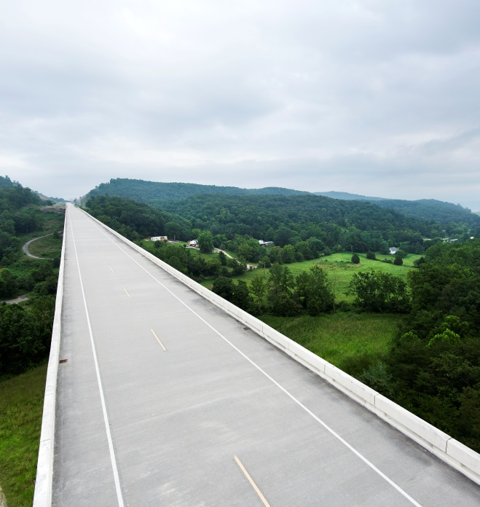
Senior Mobility, Health, & Automation
AARP/ Future of Privacy Forum Workshop Representation of Older Adults in Digital Products and Services
March 18, 2021
Jon Antin, Ph.D., CHFP
Senior Mobility, Awareness, Safety, & Health
Virginia Tech Transportation Institute

Slide 2
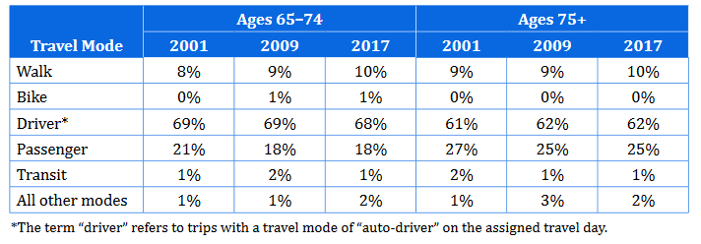
Driving Still Accounts for Majority of Trips for Seniors
From: Federal Highway Administration (2019). Travel trends for teens and seniors: 2017 National Household Travel Survey, U.S. Department of Transportation, Washington .C. Available online at https://nhts.ornl.gov/

Slide 3
Health-Related Impacts of Reduced Mobility for Seniors
Depression (Chihuri et al., 2016; Choi and DiNitto, 2016 Edwards et al., 2009)
Feelings of isolation/loneliness (Musselwhite and Haddad, 2010; van Den Berg et al., 2016; Jackson et al., 2019; Chihuri et al., 2016; Edwards et al., 2009)
Shortened lifespan (Chihuri et al., 2016; Edwards et al., 2009)
Poorer physical condition (Chihuri et al., 2016; Edwards et al., 2009)
Reduced participation in outside life/activities (Chihuri et al., 2016)
Impaired cognitive function (Chihuri et al., 2016)
Notes:
Chihuri, S., Mielenz, T. J., DiMaggio, C. J., Betz, M. E., DiGuiseppi, C., Jones, V. C., & Li, G. (2016). Driving cessation and health outcomes in older adults. Journal of the American Geriatrics Society, 64(2), 332-341.
Choi, N. G., & DiNitto, D. M. (2016). Depressive symptoms among older adults who do not drive: association with mobility resources and perceived transportation barriers. The Gerontologist, 56(3), 432-443.
Edwards, J. D., Lunsman, M., Perkins, M., Rebok, G. W., & Roth, D. L. (2009). Driving cessation and health trajectories in older adults. Journals of Gerontology Series A: Biomedical Sciences and Medical Sciences, 64(12), 1290-1295.
Jackson, S. (2019). Reducing loneliness among older adults through providing free travel access: A population-based assessment of social isolation and free bus travel in older adults in England.
Musselwhite, C., & Haddad, H. (2010). Mobility, accessibility and quality of later life. Quality in Ageing and Older Adults.
van den Berg, P., Kemperman, A., de Kleijn, B., & Borgers, A. (2016). Ageing and loneliness: the role of mobility and the built environment. Travel Behaviour and Society, 5, 48-55.

Slide 4
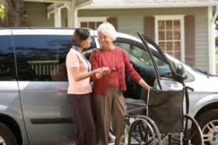

Risk Factors for Senior Drivers
Functional Impairment
Cognitive
Perceptual
Psychomotor
Physical (strength and flex)
Medicines and medical conditions
Frailty/Fragility
Training issues/bad habits
Reduced mobility – Safety not the only concern

Slide 5
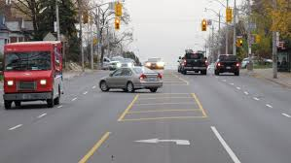
Senior Driver Solution Space
Training
Cognitive, Physical, or Driver (e.g., AARP)
Driving Restrictions
Night
Distance from home / unknown dest.
Unprotected turns across path (UTAP)
High speed roads
Fitness to Drive Screening
F(x)al limitations → prescribed restrictions
Cessation (last resort)
Technology
Safer cars: active & passive safety
Low tech assistive devices – SW grip, pedal xtenders, etc.
High tech – ADAS & automation

Slide 6
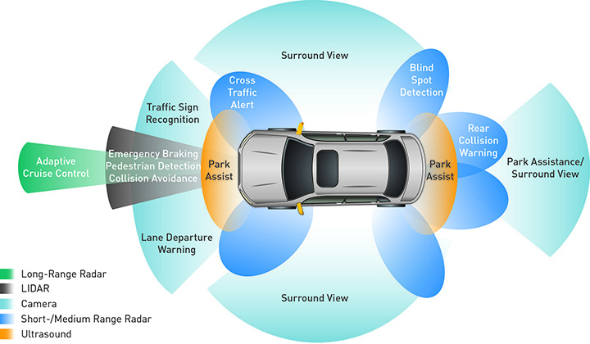
Seniors Attitudes towards Advanced Technology
Generations Survey (NHTSA) – 1,000 drivers
oldest generation (“Silent”) exhibited least interest and comfort with advanced technology
But they owned & used ADAS at approximately the same rates as middle generations
Owens, Antin, Doerzaph, and Willis (2015)

Slide 7
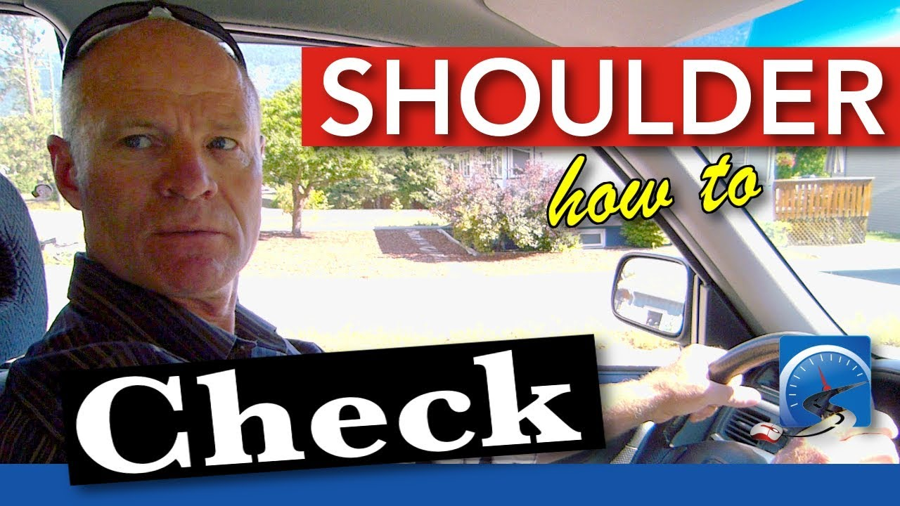
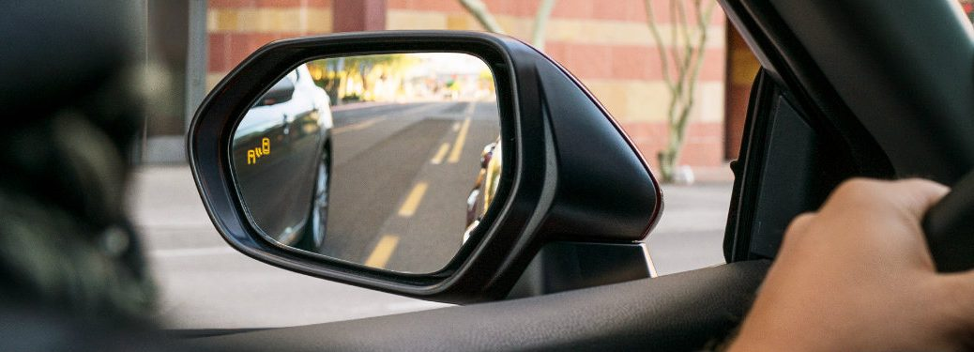
Older Driver Lane Change (NSTSCE)
Antin, Wotring, Perez, and Glaser (2020)
Seniors (70+) are doing VERY few OTS checks during lane changes!
ADAS (i.e., BSM) can play a role

Slide 8
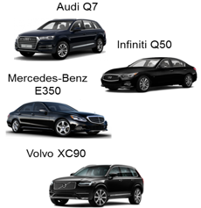


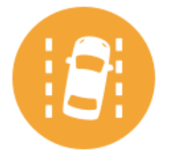
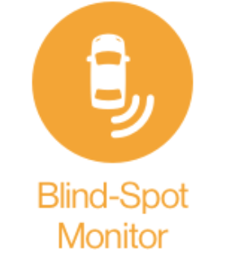
ADAS Exposure Study
2017
Pilot NDS (Blacksburg/ New River Valley area of VA)
18 participants
9 male, 9 female
Age range: 70-79
ADAS-Equipped Vehicles
2015
ADAS
Adaptive Cruise Control
Lane Keep Assist
Lane Departure Alert
Blind Spot Warning
2016
2016
ADS Attitudes Survey
Pre-Study Survey
Vehicle Orientation & ADS Training
Post-study Survey
Focus Group
ADAS Vehicle NDS
← 6 weeks →
Weekly phone interview
Liang, Lau, Baker, Antin (2020)

Slide 9
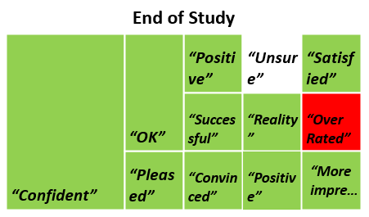
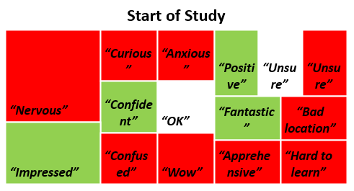
Focus Group Findings - Attitudes
Attitudes Change
Negative initial attitudes towards the advanced features
e.g. “Nervous”, “confused” and “anxious”
Positive post attitudes towards the advanced features
e.g. “Positive” and “Confident”
Liang, Lau, Baker, Antin (2020)
Notes:
start of study

Slide 10
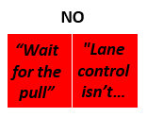
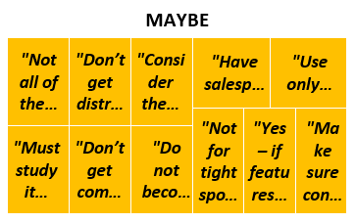
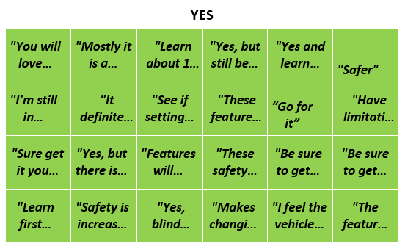
Focus Group Findings - Safety
Most agreed that the features improve safety
Learn how to use first “Learn first then buy”
Do not become over dependent on them “Don’t get complacent”
Liang, Lau, Baker, Antin (2020)

Slide 11
Drivers Knowledge of Correct Use of New Technology Features in Vehicles
Sponsor: NHTSA, Dr. Kathy Sifrit, COR (TO)/Project Manager
Prime Contractor: Dunlap & Associates
Objectives Explore…
drivers’ attitudes regarding ADAS before and after having used the systems
how drivers use these systems during on-road driving
extent to which such systems affect safety behaviors such as seat belt and child restraint system use, speeding, and distracted driving
Methods
120 participants (50% M/ 50% F); Two age groups (40-49 and 70+)
Data:
Knowledge and Attitude Questionnaire
baseline and final drives involving approximately 2-hour planned routes
NDS – 4 weeks with the ADAS activated
Notes:
https://rip.trb.org/View/1658680

Slide 12
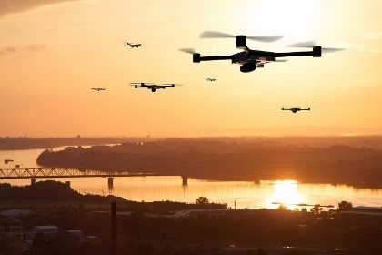
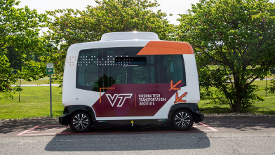
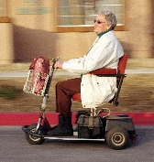
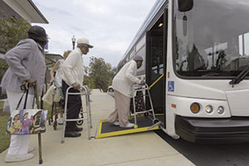
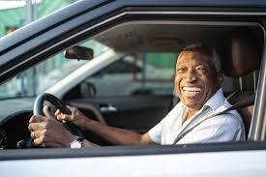
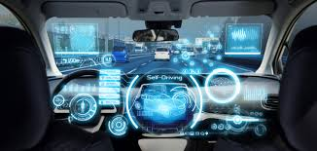
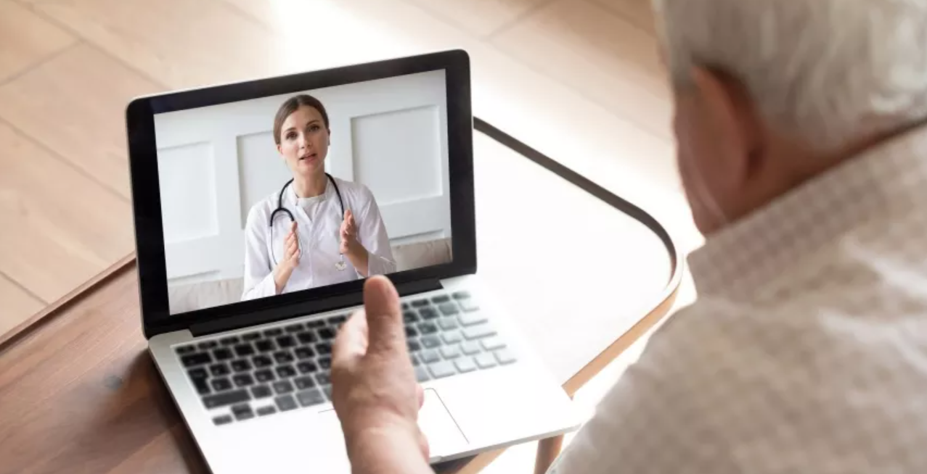
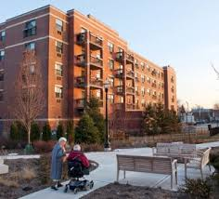
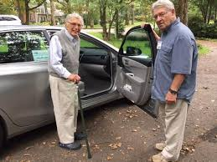
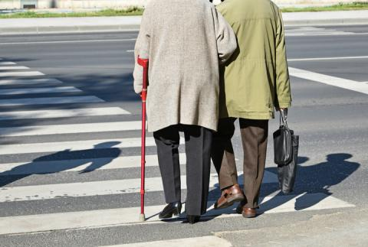

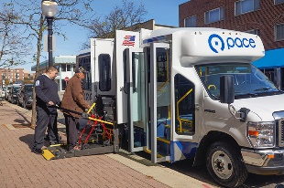
Expanding Senior Mobility Space
Personal Vehicle
Public Transit
Para-transit
Ride Hailing
Volunteer Drivers
Biking/ Walking
Personal Mobility
Connected & Automated Tech
Livable Communities

Slide 13
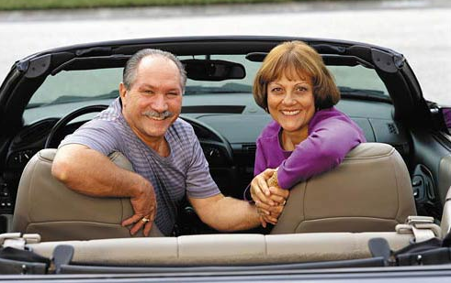
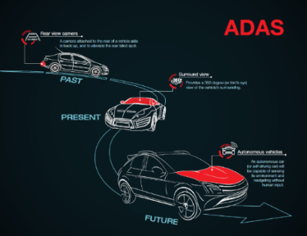
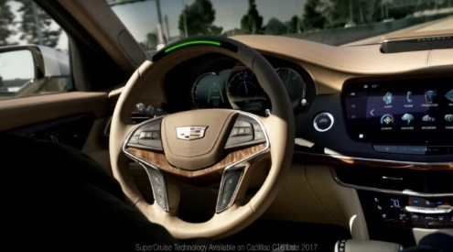
Future Senior Mobility Landscape
Growth in senior population
Next Gen Seniors – Boomers same or different?
Technologies continually emerging; transportation landscape rapidly evolving
Livable Communities
Drone Deliveries
Telehealth
COVID-19
What constitutes a social interaction?

